Slide 1
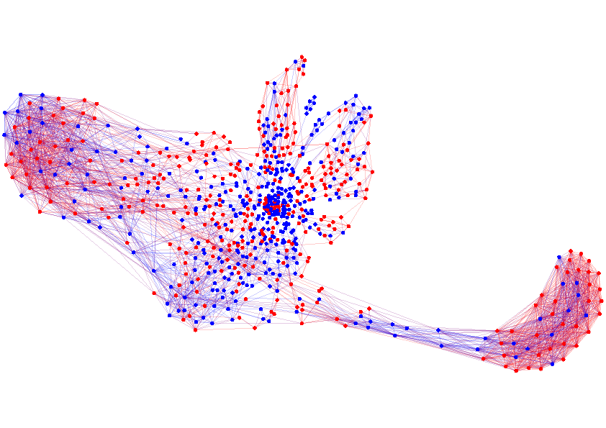
Structure and Dynamics of Information Pathways in On-line Media
Manuel Gomez Rodriguez
Stanford University MPI for Intelligent Systems
joint work with: J. Leskovec & B. Schölkopf
02.06.13 WSDM ‘13

Slide 2
Propagation over networks
Propagation takes place on
We can extract propagation traces from
Information Networks
Social Networks
Recommendation Networks
Epidemiology
Human Travels

Slide 3
Propagation over unknown networks
Propagation often takes place over implicit or hard-to-observe networks.
Implicit networks of blogs and news sites that spread news without mentioning their sources
Hard-to-observe/hidden networks of drug users that share needles among them
We observe when a node copies information or becomes infected but …
… the connectivity and transmission rates of the underlying network is unknown!

Slide 4
Examples of propagation
Propagation Process
Available data
Hidden data
Information propagation
Information propagates in the network
Time when blogs reproduce information
Who copied whom
Virus propagation
Viruses propagate in the network
Time when people get sick
Who infected whom
Recommendations propagate in the network
Viral marketing
Time when people buy products
Who influenced whom
Can we infer the hidden data from the available temporal data?

Slide 5
Weighted networks
Previously (KDD’10, NIPS’10, ICML’12)… Unweighted networks: Propagation occurs at the same rate α over each edge.
In our work (ICML’11, WSDM’13)… Weighted networks: Propagation occurs at different rates α_{j,i} over different edges.

Slide 6
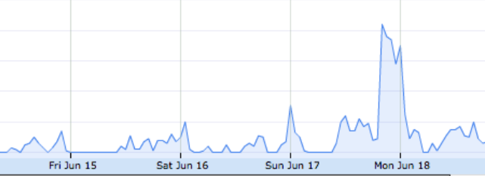
Dynamic networks
0
T
Previously (KDD’10, NIPS’10, ICML ‘11, ICML’12)… Propagation over static networks with fixed transmission rates
However… Networks and rates change over time
#greece retweets
0
T
In our work (WSDM’13)… Propagation over dynamic networks and variable transmission rates

Slide 7
Inferring dynamic weighted networks
Information propagates on a dynamic directed network at different transmission rates:
0
T
n₃
n₃
n₃
n₃
n₃
n₂
n₂
n₃
n₂
n₂
n₂
n₈
n₈
n₂
n₈
n₈
n₈
n₁
n₁
n₈
n₁
n₁
n₁
n₁
n₇
n₇
n₇
n₇
n₇
n₄
n₄
n₇
n₄
n₄
n₄
n₆
n₆
n₄
n₆
n₆
n₆
n₅
n₅
n₆
n₅
n₅
n₅
n₅
n₉
n₉
n₉
n₉
n₉
n₁₀
n₁₀
n₉
n₁₀
n₁₀
n₁₀
n₁₀
Cascade c₁: (n₁, t₁=1), (n₂, t₂=4), (n₃, t₃=6), (n₆, t₆=11)…
Our aim is to infer the dynamic network and the variable transmission rates only from the temporal traces
Cascade c₅₀₀: (n₁, t₁=34), (n₄, t₂=40), (n₅, t₃=42), (n₂, t₆=44)…
Cascade c₁₀₀₀: (n₁, t₁=87), (n₄, t₂=88), (n₂, t₃=90), (n₅, t₆=96)…
Cascade c₂: (n₂, t₁=3), (n₅, t₂=10), (n₃, t₃=12), (n₄, t₄=23)…
Cascade c₅₀₁: (n₉, t₁=50), (n₅, t₂=51), (n₁₀, t₃=58), (n₆, t₄=63)…
Cascade c₁₀₀₁: (n₆, t₁=92), (n₇, t₂=96), (n₃, t₃=97), (n₈, t₄=98)…
Notes:
Stronger colors

Slide 8
Outline
Introduce a continuous time propagation model to explain the observed cascades.
Formulate the dynamic network inference problem using our propagation model.
Develop an efficient algorithm to solve the dynamic network inference problem.
Validate our algorithm on synthetic and real diffusion data, and discover qualitative insights about propagation in real information networks.

Slide 9
Continuous time propagation model
1. Likelihood of transmission of an edge
j
i
2. Likelihood of infection of a node
l
DAG
3. Likelihood of a cascade
k
t_{j}
t_{k}
t_{l}
t_{i}
infection times
Cascade
Notes:
acyclic

Slide 10
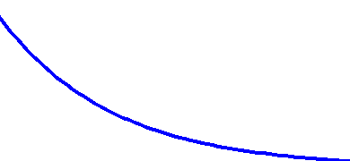
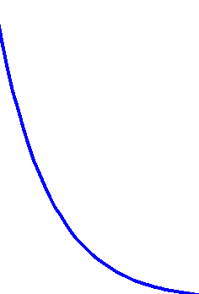
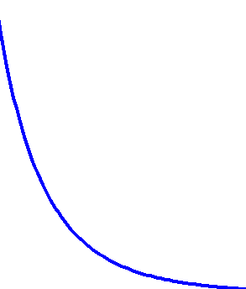
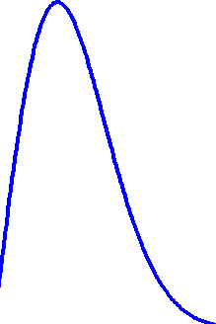
Likelihood of transmission
Likelihood of tx of edge :
j
i
It depends on the tx time (t_{i} – t_{j}) and the tx rate α_{(j, i)}
Exp
Social and Information Diffusion Models
Pow
Epidemiology
Ray
t_{j}-t_{i}
t_{j}-t_{i}
small α_{j,i}
big α_{j,i}
As α_{j,i} 0, likelihood 0 and E[tx time] ∞

Slide 11
Probability of survival
The survival function of edge is the probability that node is not infected by node by time t_{i}:
j
i
i
j
t_{j}
t_{i}

Slide 12
Likelihood of an infection
A node gets infected once the first parent infects it.
i
What is the likelihood of infection of node at time t_{i} when node is the first parent?
i
j
i
j
k
l
j
i
k
i
l
i
×
×
t_{j}
t_{i}
t_{k}
t_{i}
t_{l}
t_{i}

Slide 13
Likelihood of an infection
The likelihood of infection of node results from summing up over the mutually disjoint events that each potential parent is the first parent:
i
i
l
×
×
+
j
k
t_{j}
t_{i}
t_{k}
t_{i}
t_{l}
t_{i}
i
l
×
×
+
j
k
t_{j}
t_{i}
t_{k}
t_{i}
t_{l}
t_{i}
i
l
×
×
j
k
t_{j}
t_{i}
t_{k}
t_{i}
t_{l}
t_{i}

Slide 14
Likelihood of a cascade
The likelihood of the infections in a cascade is:
Source
a
d
1st infection
c
2nd infection
3rd infection
b
Parent j is the 1st parent infecting i
Any parent k≠j infects i later than j
Sweep over infected nodes
Sweep over potential parents

Slide 15
Dynamic Network Inference
Dynamic network inference problem:
We penalize old cascades!
Tradeoff:
Tracking changing transmission rates fast requires forgetting old cascades quickly
Forgetting old cascades too quickly results in less reliable estimates

Slide 16
Convexity of Network Inference
Theorem. Given log-concave survival functions and concave hazard functions in A, the dynamic network inference problems is convex in A.
Corollary. The dynamic network inference problems are convex for the exponential, power-law and Rayleigh models.

Slide 17
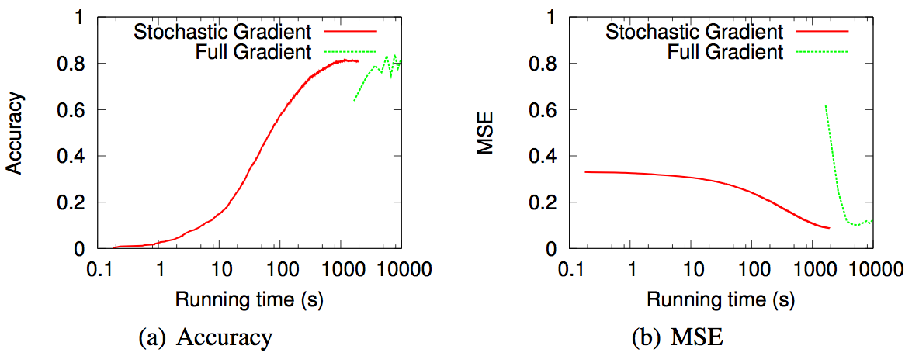
InfoPath: stochastic algorithm
Algorithm: InfoPath
We developed InfoPath, a stochastic gradient descend algorithm, to solve dynamic network inference problem:
Typically, one order of magnitude faster than full gradient descend.
Per iteration:
Sampled cascade!

Slide 18
Synthetic experiments: setup
We validate our method on:
Synthetic data
1. We generate network structure (Kronecker/Forest Fire)
2. We assign transmission rate trends and generate transmission rate time series (dynamic networks)
4. Run our algorithm to infer dynamic networks
5. Evaluate our method computing precision, recall, accuracy and normalized mean absolute error (MAE)

Slide 19
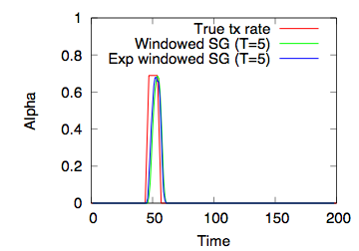
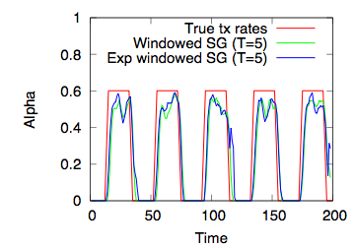
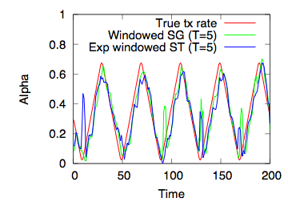
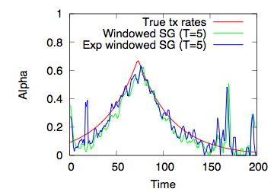
Performance vs rate trend
1000 cascades per time unit, exponential transmission model 1,024 node Kronecker Core-Periphery network
Our stochastic method is able to track different transmission rate trends

Slide 20
Real experiments: setup
We validate our method on:
Real data
1. We crawl over 179 million quotes from 3.3 million sites from March 2011 to February 2012.
2. We filter posts per topic or news events (in practice, by keywords)
3. We extract memes cascades for every topic/news event
4. Run our algorithm to infer time-varying networks for every topic/news event

Slide 21
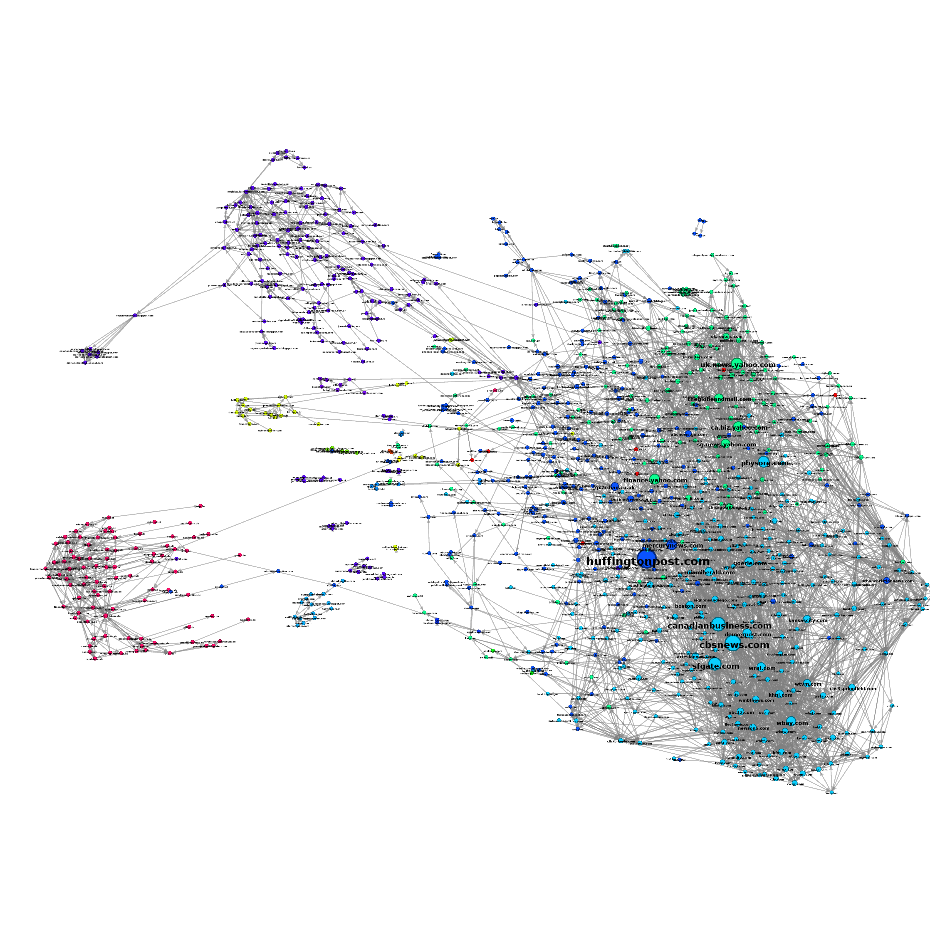
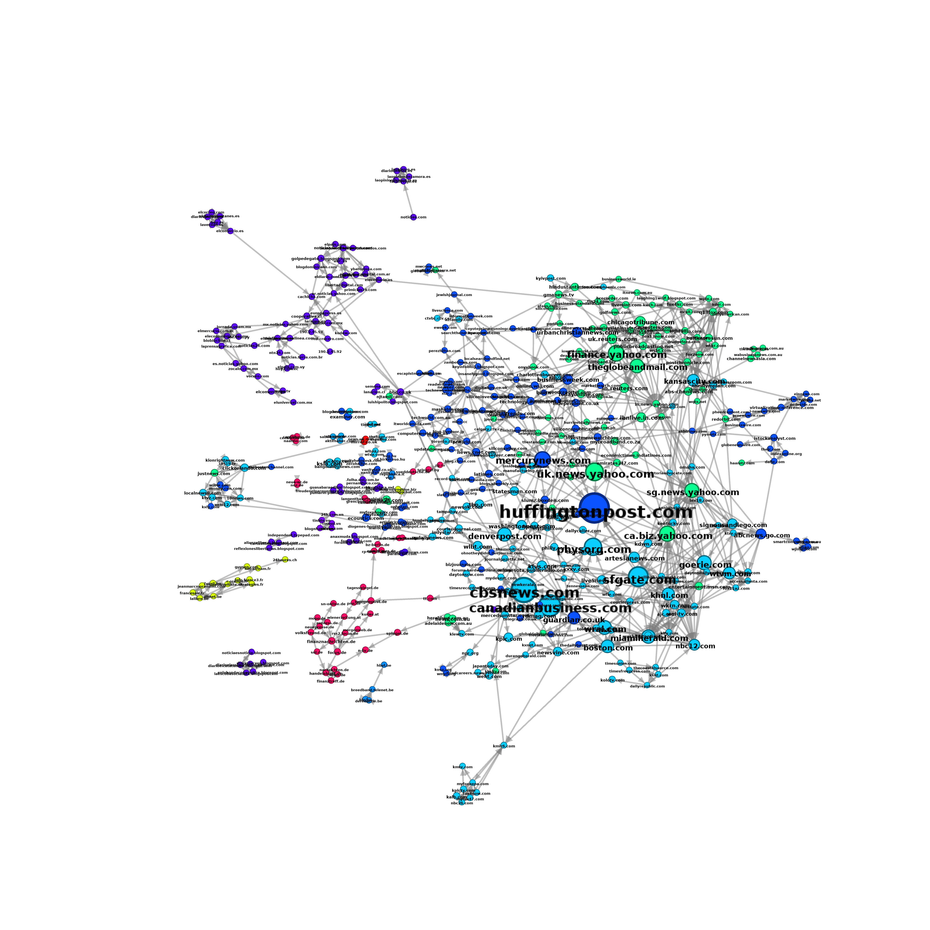
Observation I: Events
Youtube video: http://youtu.be/hBeaSfRCU4c
Steve Jobs 2011-07-01 (3 months before his dead)
Steve Jobs 2011-10-10 (5 days after his dead)

Slide 22
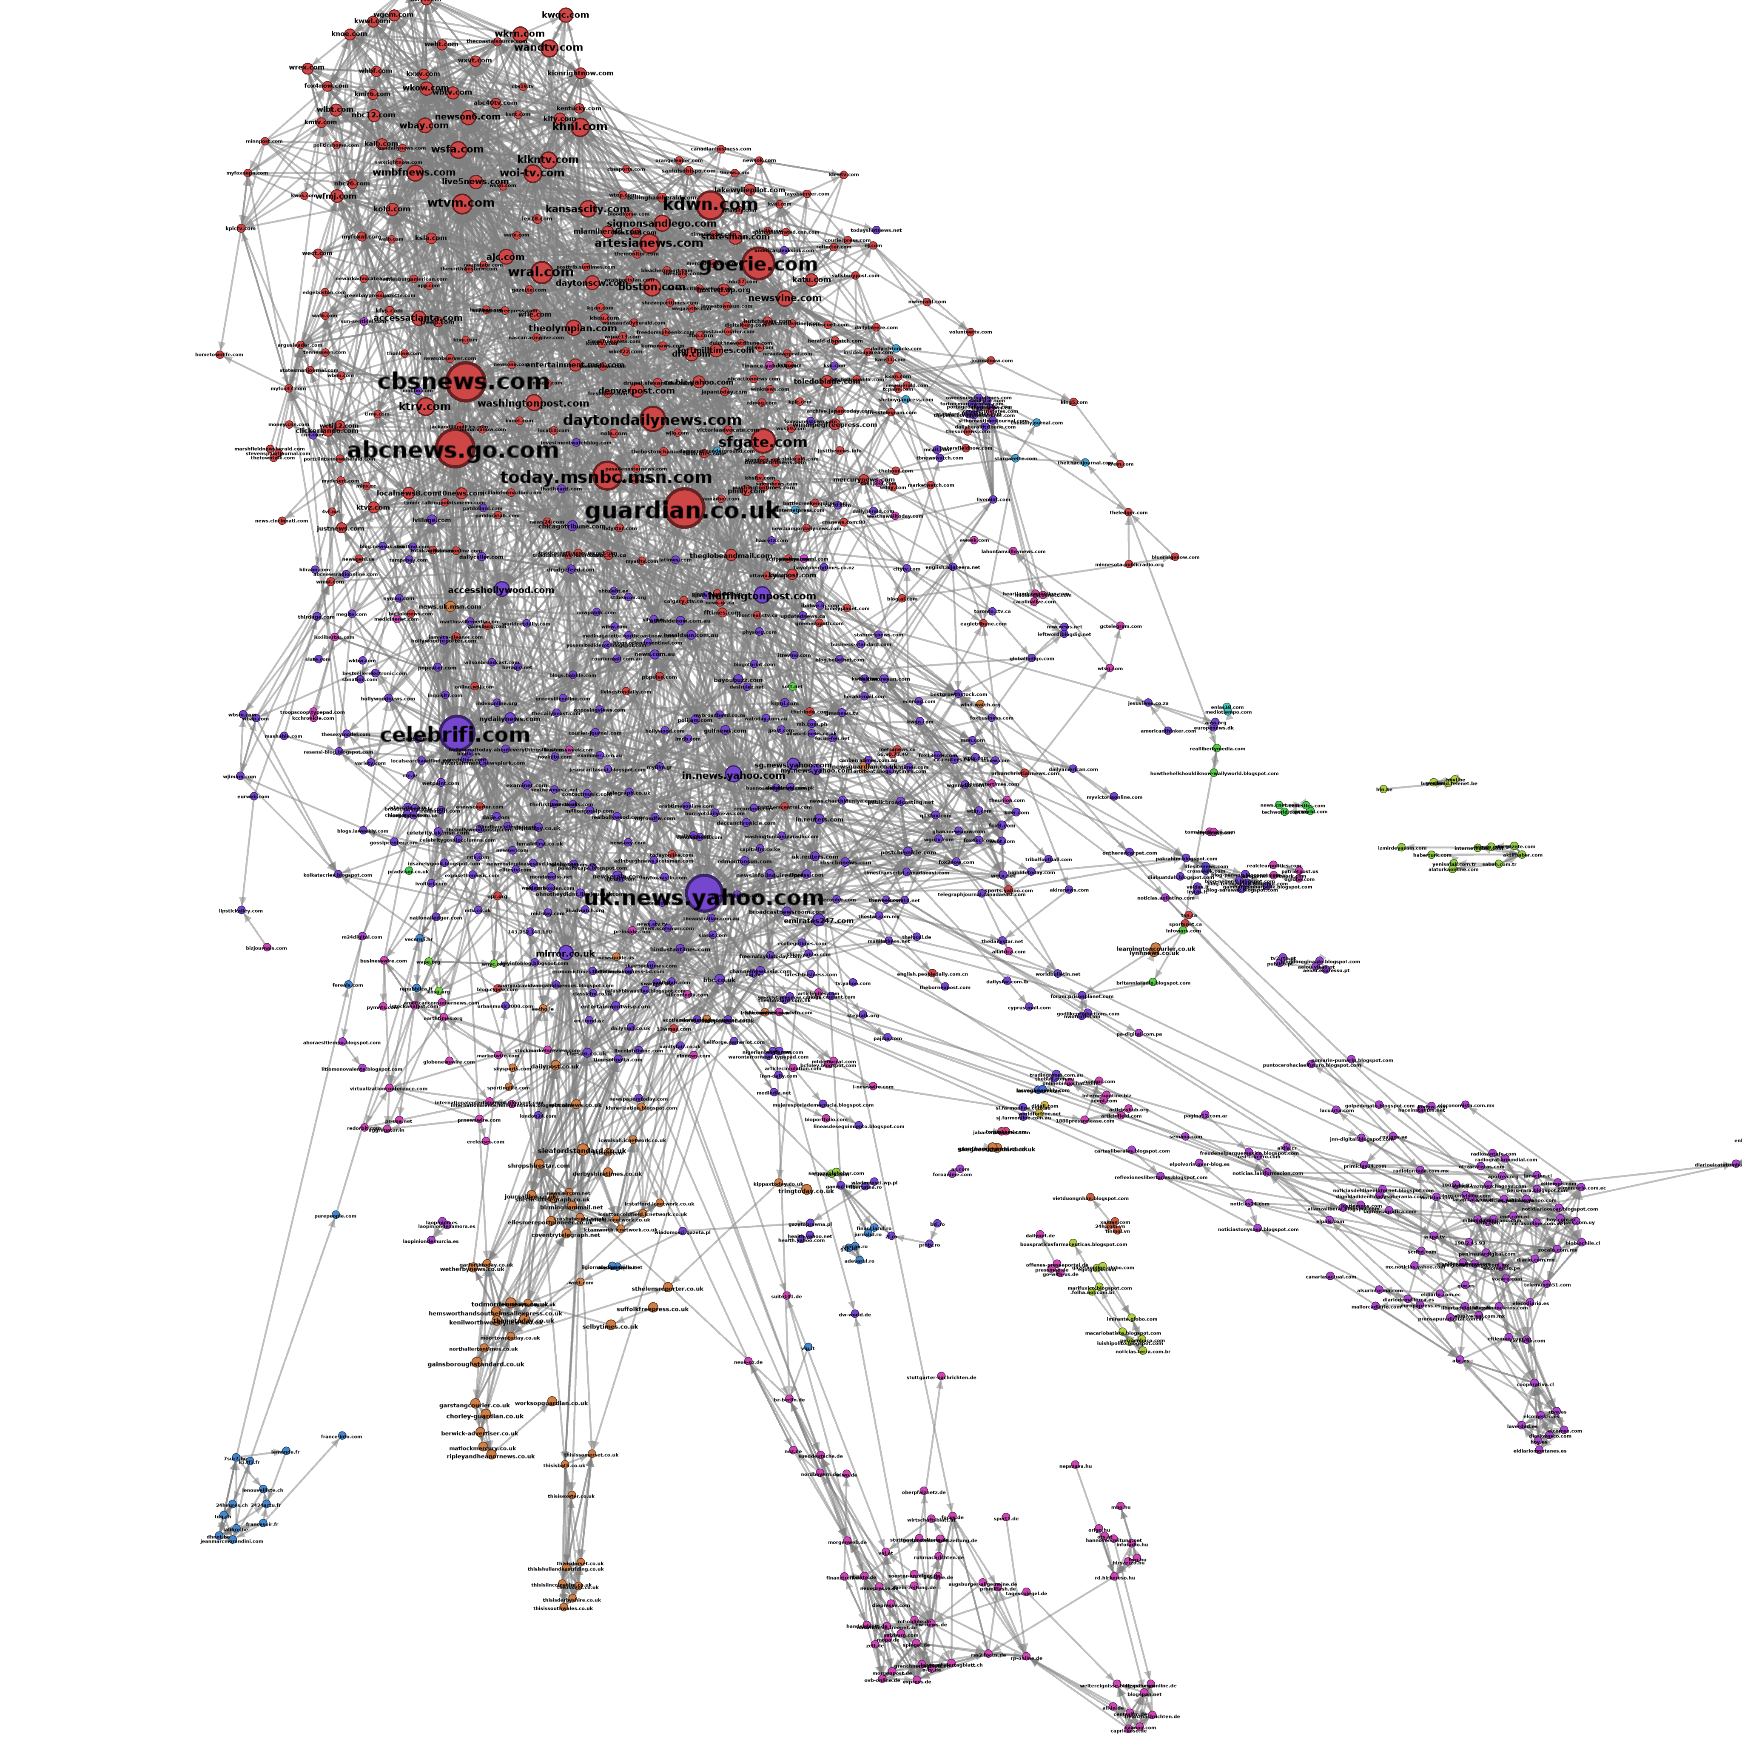
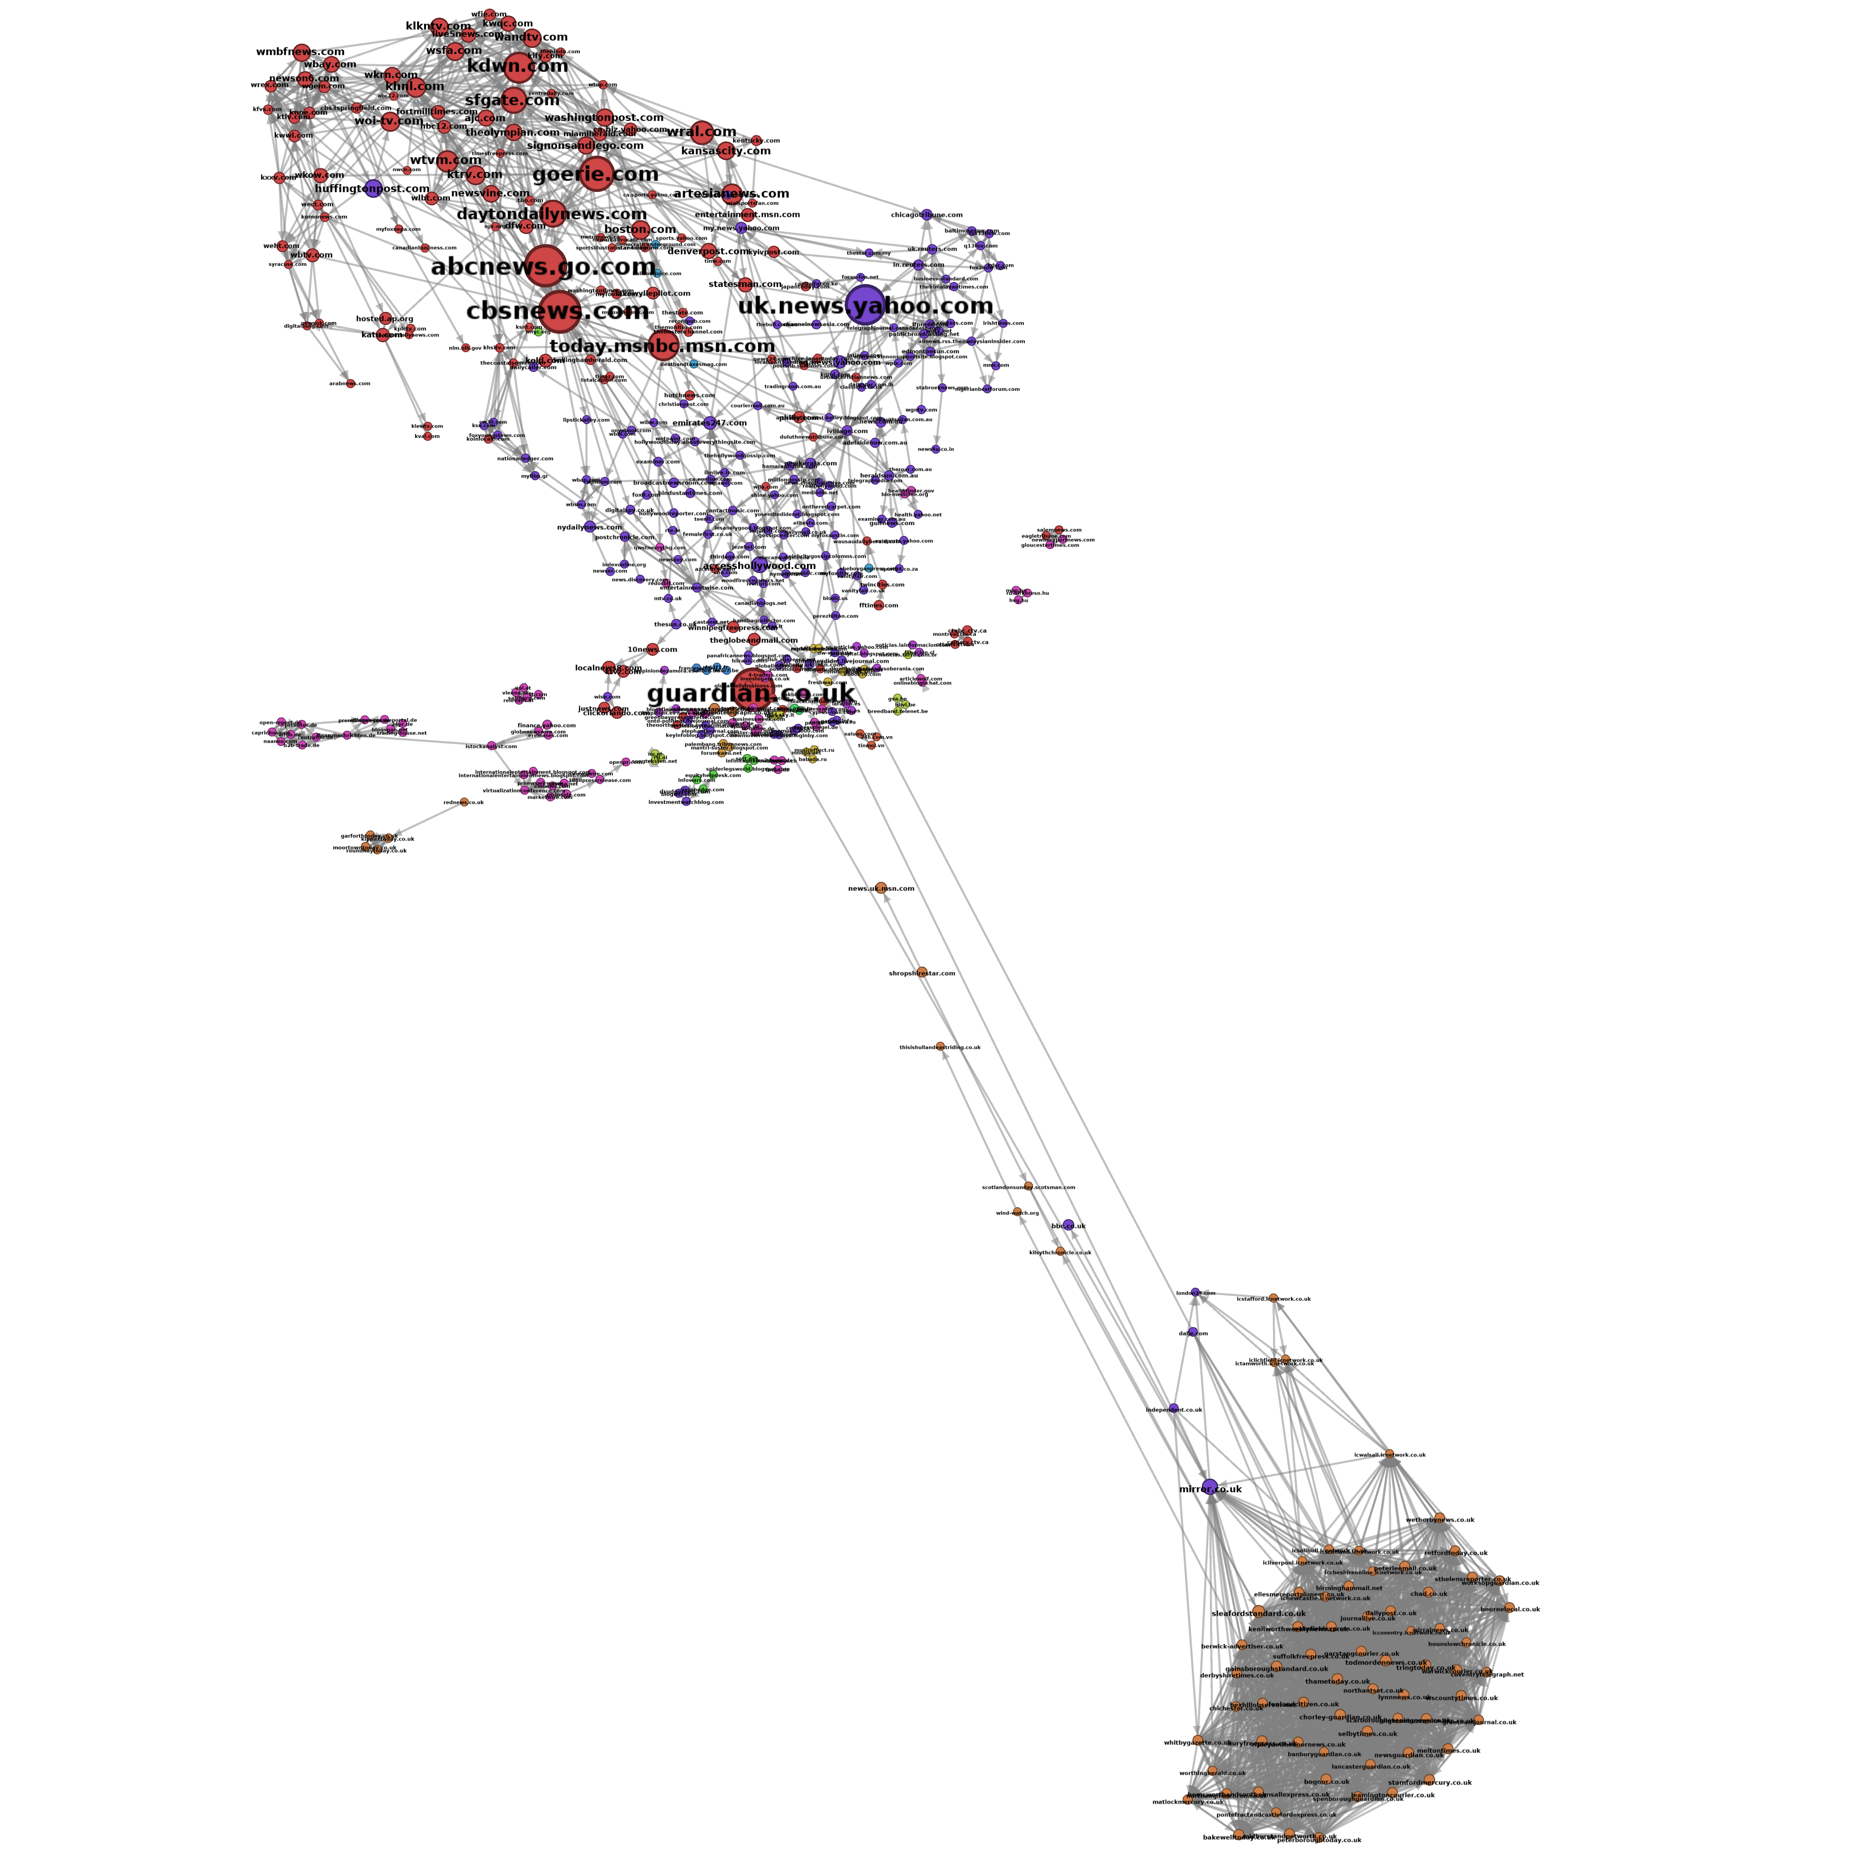
Observation II: Dynamic Clusters
Youtube video: http://youtu.be/hIeF9NMSCLo
UK sites
UK Royal wedding 2011-05-02 (3 days after the wedding)
UK Royal wedding 2011-11-15 (6 months after the wedding)

Slide 23
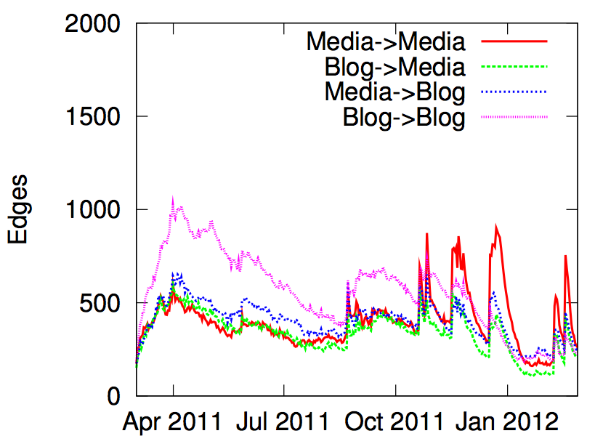
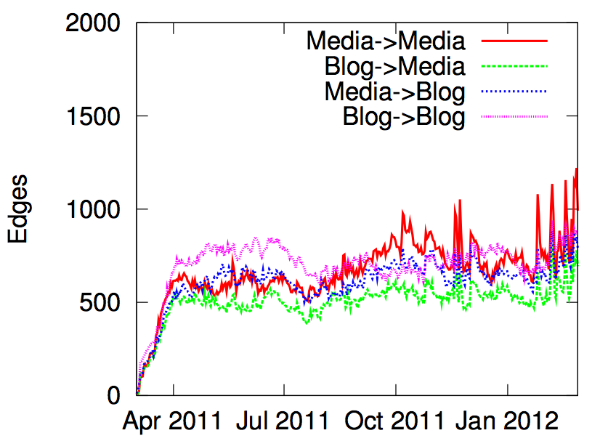
Observation III: population wide event
Civil war in Libya
Syria’s uprise
News are sometimes spreading earlier among blogs than mass media, often when civil population is involved, as the civil war in Libya or Syria’s uprise.

Slide 24
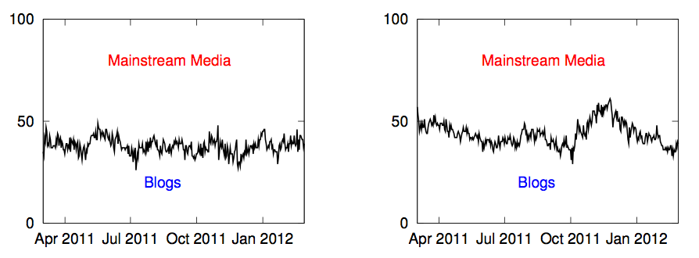
Observation IV: centrality
NBA
Occupy Wall Street
The distribution of mainstream media and blogs among the most central sites can be relatively steady (NBA) or more time-varying (Occupy Wall Street).

Slide 25
Conclusions
We introduced fully continuous time model for diffusion and propagation processes:
We make minimal assumptions about the physical, biological or cognitive mechanisms responsible for diffusion.
The model uses only the temporal traces left by diffusion.
We developed InfoPath, an on-line algorithm to infer time-evolving weighted networks from diffusion traces:
We study how real networks and information pathways evolve over time on a massive real dataset.

Slide 26
Thanks!
More At:
http://snap.stanford.edu/infopath
Photo: Wakhan Valley from Yamchun Fort, Pamirs

