Slide 1
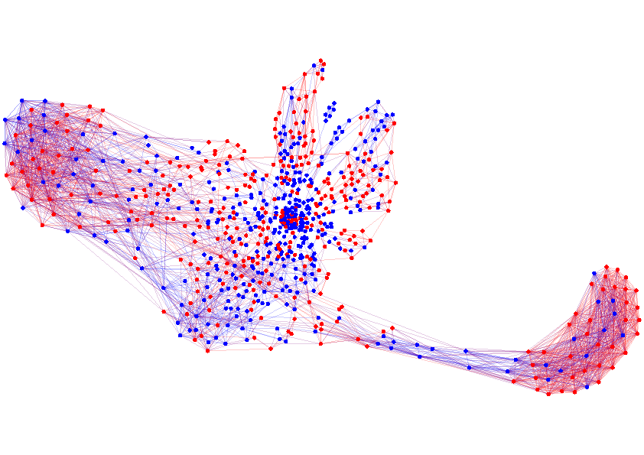
Structure and Dynamics of Information Pathways in On-line Media
Manuel Gomez Rodriguez
05.09.12 Workshop Menorca, MPI for Intelligent Systems

Slide 2
Propagation over networks
Propagation takes place on
We can extract propagation traces from
Information Networks
Social Networks
Recommendation Networks
Epidemiology
Human Travels

Slide 3
Propagation over unknown networks
Diffusion often takes place over implicit or hard-to-observe networks.
Implicit networks of blogs and news sites that spread news without mentioning their sources
Hard-to-observe/hidden networks of drug users that share needles among them
We observe when a node copies information or becomes infected but …
… the connectivity and the temporal dynamics of the underlying network are unknown!

Slide 4
Examples of diffusion
Diffusion Process
Available data
Hidden data
Information propagation
Information propagates in the network
Time when blogs reproduce information
Who copied whom
Virus propagation
Viruses propagate in the network
Time when people get sick
Who infected whom
Recommendations propagate in the network
Viral marketing
Time when people buy products
Who influenced whom
Can we infer the hidden data from the available temporal data?

Slide 5
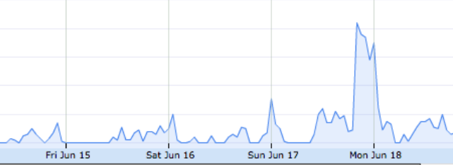
Static vs dynamic networks
0
T
First… We consider propagation over static networks with fixed dynamics
However… Networks and dynamics change over time
#greece retweets
0
T
Then… We consider propagation over dynamic networks with variable dynamics

Slide 6
Propagation on static networks
Information propagates on a static directed network at different transmission rates:
Cascade 1
Cascade 2
Our aim is to infer the network and the dynamics only from the cascades
We do not observe edges nor tx rates, only when a diffusion reaches a node.

Slide 7
Propagation on dynamic networks
Information propagates on a dynamic directed network at different transmission rates:
0
T
n₃
n₃
n₃
n₃
n₃
n₂
n₂
n₃
n₂
n₂
n₂
n₈
n₈
n₂
n₈
n₈
n₈
n₁
n₁
n₈
n₁
n₁
n₁
n₁
n₇
n₇
n₇
n₇
n₇
n₄
n₄
n₇
n₄
n₄
n₄
n₆
n₆
n₄
n₆
n₆
n₆
n₅
n₅
n₆
n₅
n₅
n₅
n₅
n₉
n₉
n₉
n₉
n₉
n₁₀
n₁₀
n₉
n₁₀
n₁₀
n₁₀
n₁₀
Cascade c₁: (n₁, t₁=1), (n₂, t₂=4), (n₃, t₃=6), (n₆, t₆=11)…
Our aim is to infer the dynamic network and the variable dynamics only from the temporal traces
Cascade c₅₀₀: (n₁, t₁=34), (n₄, t₂=40), (n₅, t₃=42), (n₂, t₆=44)…
Cascade c₁₀₀₀: (n₁, t₁=87), (n₄, t₂=88), (n₂, t₃=90), (n₅, t₆=96)…
Cascade c₂: (n₂, t₁=3), (n₅, t₂=10), (n₃, t₃=12), (n₄, t₄=23)…
Cascade c₅₀₁: (n₉, t₁=50), (n₅, t₂=51), (n₁₀, t₃=58), (n₆, t₄=63)…
Cascade c₁₀₀₁: (n₆, t₁=92), (n₇, t₂=96), (n₃, t₃=97), (n₈, t₄=98)…
Notes:
Stronger colors

Slide 8
Outline
Efficiently compute the likelihood of the observed cascades in a continuous time model of diffusion
Efficiently solve the static and the dynamic network inference problems using the likelihood of the observed cascades
Validate our algorithm on synthetic and real diffusion data.
Discover qualitative insights about propagation in real information networks.

Slide 9
Computing the likelihood of a cascade
1. Likelihood of tx of an edge
j
i
2. Probability of survival of a node
l
3. Likelihood of infection of a node
DAG
4. Likelihood of a cascade
k
t_{j}
t_{k}
t_{l}
t_{i}
Infection times
Cascade

Slide 10
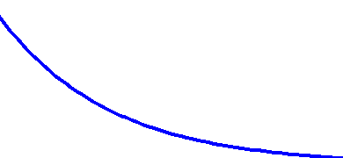
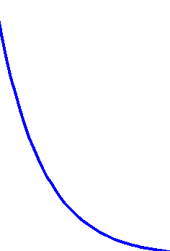
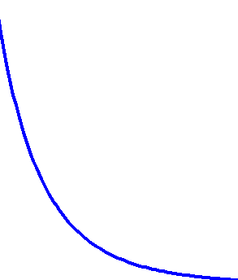
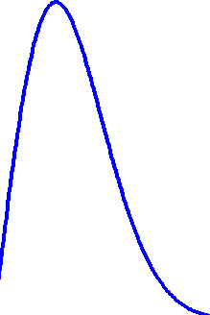
Likelihood of transmission
Likelihood of tx of edge :
j
i
It depends on the tx time (t_{i} – t_{j}) and the tx rate α_{(j, i)}
Exp
Social and Information Diffusion Models
Pow
Epidemiology
Ray
t_{j}-t_{i}
t_{j}-t_{i}
small α_{j,i}
big α_{j,i}
As α_{j,i} 0, likelihood 0 and E[tx time] ∞

Slide 11
Survival and Hazard
The survival function of edge is the probability that node is not infected by node by time t_{i}:
j
i
i
j
t_{j}
t_{i}
The hazard function, or instantaneous infection rate, of edge is the ratio:
j
i

Slide 12
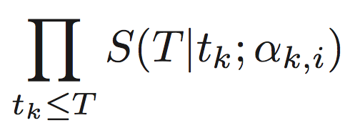
Probability of survival
Probability of survival of a node until time T for a cascade (t₁, ..., t_{N}):
i
≤ 1
j
i
k
l
j
i
k
i
l
i
×
×
t_{j}
T
t_{k}
T
t_{l}
T

Slide 13
Likelihood of an infection
A node gets infected once the first parent infects it.
i
What is the likelihood of infection of node at time t_{i} when node is the first parent?
i
j
i
j
k
l
j
i
k
i
l
i
×
×
t_{j}
t_{i}
t_{k}
t_{i}
t_{l}
t_{i}

Slide 14
Likelihood of an infection
The likelihood of infection of node results from summing up over the mutually disjoint events that each potential parent is the first parent:
i
i
l
×
×
+
j
k
t_{j}
t_{i}
t_{k}
t_{i}
t_{l}
t_{i}
i
l
×
×
+
j
k
t_{j}
t_{i}
t_{k}
t_{i}
t_{l}
t_{i}
i
l
×
×
j
k
t_{j}
t_{i}
t_{k}
t_{i}
t_{l}
t_{i}

Slide 15
Connection to Survival Theory
The likelihood of infection of node :
i
The hazard of node :
i
Covariates: sign(t_{i}-t_{j}) for exponential 1/(t_{i}-t_{j}) for power-law (t_{i}-t_{i}) for Rayleigh
A particular case of Aalen’s model for survival analysis!
Baseline: In our model is 0 (external causes?)
Parameters: Tx rates α_{j, i}

Slide 16
Likelihood of a cascade
The likelihood of the infections in a cascade is:
j
Source
i
l
1st infection
2nd infection
3rd infection
k

Slide 17
Likelihood of a cascade
The likelihood of (the infections and non-infections in) a cascade is:
Non infected nodes
Infected
nodes

Slide 18
Static & Dynamic Network Inference
Static network inference problem:
We penalize old cascades!
Dynamic network inference problem:

Slide 19
Convexity of Network Inference
Theorem. Given log-concave survival functions and concave hazard functions in A, the static and the dynamic network inference problems are convex in A.
Corollary. The static and the dynamic network inference problems are convex for the exponential, power-law and Rayleigh models.

Slide 20
Connection to Causality
We just showed that under some conditions, we are able to find a single unique solution. We find a unique network that best explains all cascades.
In every cascade:
t_{i} = min(t₁+Δ₁, t₂+Δ₂, …, t_{i-1} + Δ_{i-1})
Functional model from Causality!!
= f_{i}({t₁,…,t_{i-1}}, s_{i})
Random variable
Parents
Independent Noise
In our case, every cascade induces a DAG on the network, but the network contain loops.

Slide 21
Properties of the formulation
The log-likelihood of a set of cascades has three terms with desirable easy-to-interpret properties:
Survival terms
Hazard term

Slide 22
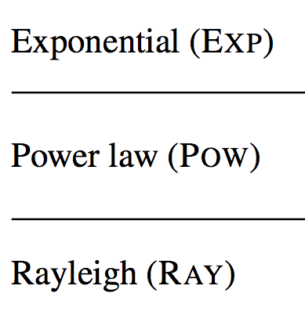
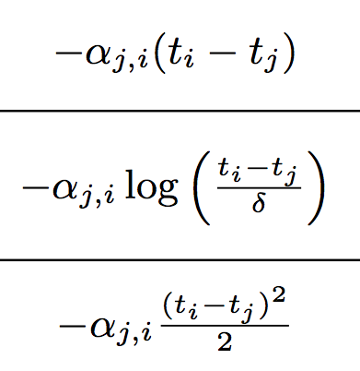
Properties of the formulation
For Exp, Pow and Ray likelihood of tx, the survival terms are positively weighted l₁-norms:
This encourages sparse solutions
It arises naturally within the probabilistic model!

Slide 23
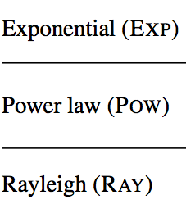
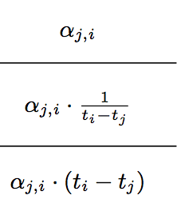
Properties of the formulation
For Exp, Pow and Ray likelihood of tx, the Hazard term ensures infected nodes have at least one parent:
It weakly rewards a node having many parents (natural diminishing property on # of parents).

Slide 24
Solving the network inference problem
Solving NetRate
Initially: we use CVX (Grand & Boyd, 2010) to solve the static network inference problem:
General purpose solver (SDPs, conic programming)
Rapid prototyping
Then: we developed a customized stochastic gradient descend implementation, to solve both the static & dynamic network inference problem.
Typically, one order of magnitude faster than CVX.
Per iteration:
Sampled cascade!

Slide 25
Speeding-up our method
Speeding-Up Network Inference
1. Distributed optimization (static & dynamic):
NetRate splits into N subproblems, one for each node i, in which we find N −1 rates α_{j,i}, j = 1, …, N \ i.
2. Null rates (static & dynamic):
If a pair (j, i) is not in any common cascade, the optimal α_{j,i} is zero because it is only weighted negatively in the objective.
3. Weighted sampling (dynamic):
We use weighted sampling instead of penalizing each cascade by w_{c}(t).

Slide 26
Synthetic experiments: setup
We validate our method on:
Synthetic data
1. We generate network structure
2. We assign: a) Constant transmission rates (static networks) b) Transmission rate trends and generate transmission rate time series (dynamic networks)
4. Run our algorithm to infer static & dynamic networks
5. Evaluate our method computing precision, recall, accuracy and normalized mean absolute error (MAE)

Slide 27
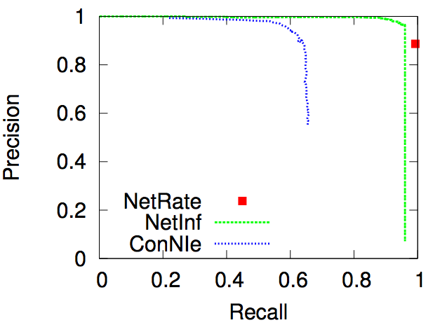
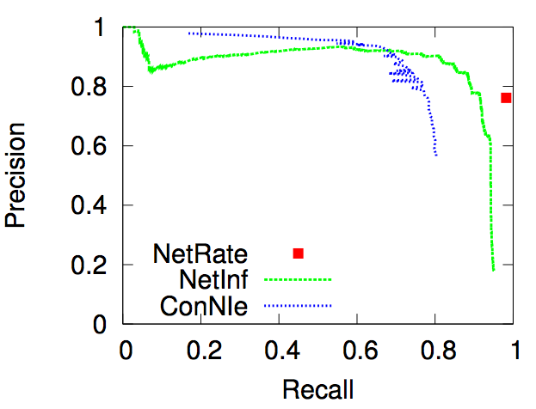
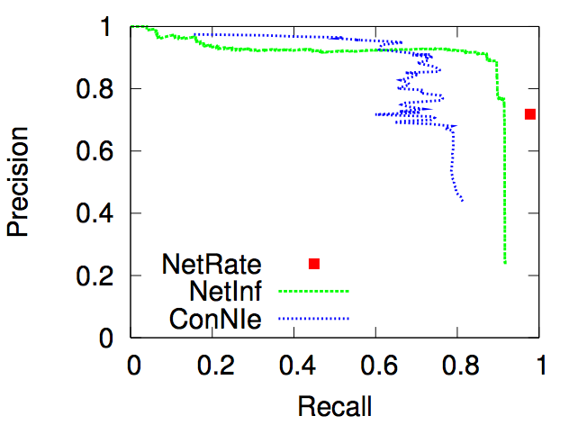
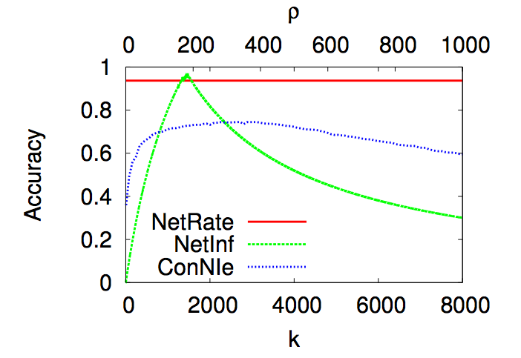
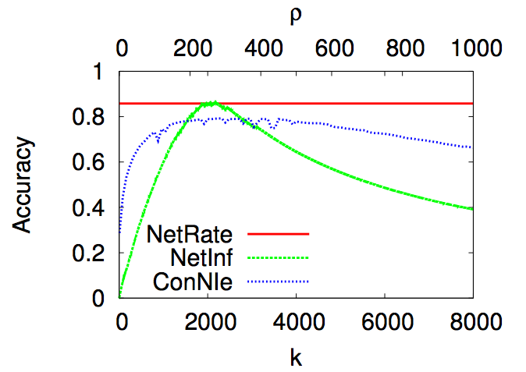
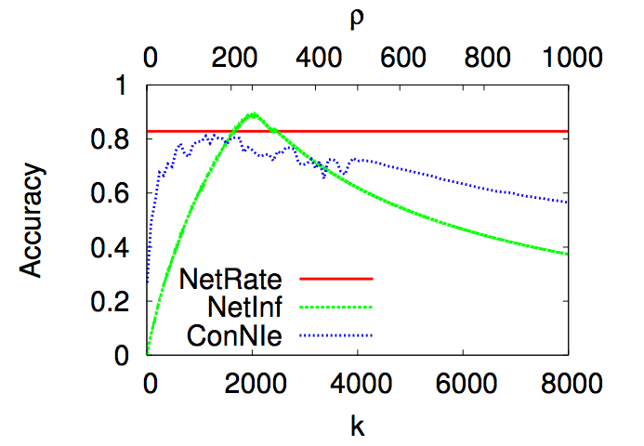
Performance vs network structure
Hierarchical Kronecker, Exp
Forest Fire, Pow
Random Kronecker, Ray
We beat the state-of-the-art for static networks across a significant part of the full range of their tunable parameters.

Slide 28
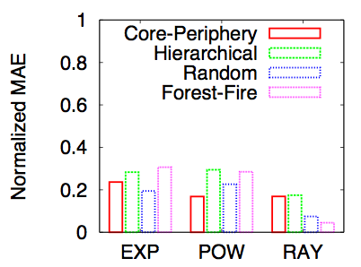
Performance vs transmission model
Three types of (1,024 nodes, 2,048 edges) Kronecker networks and a (1,024 nodes, 2,422 edges) Forest Fire network with 5,000 cascades
Our method is stable across transmission rate models and static network structures.

Slide 29
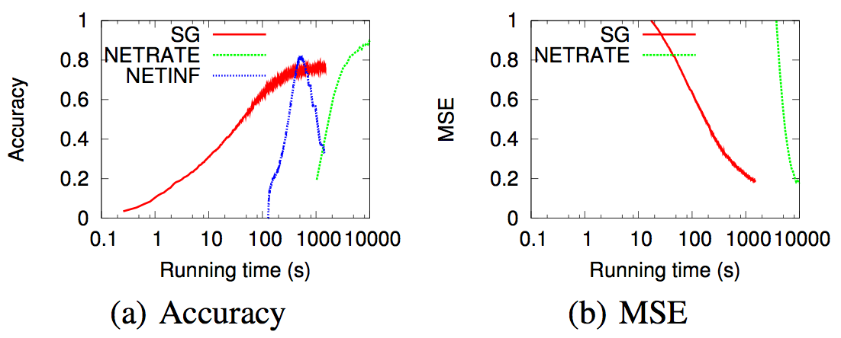
Performance vs scalability
Our stochastic method is approx. one order of magnitude faster in static networks than NetRate and as fast as NetInf, while achieving comparable accuracy

Slide 30
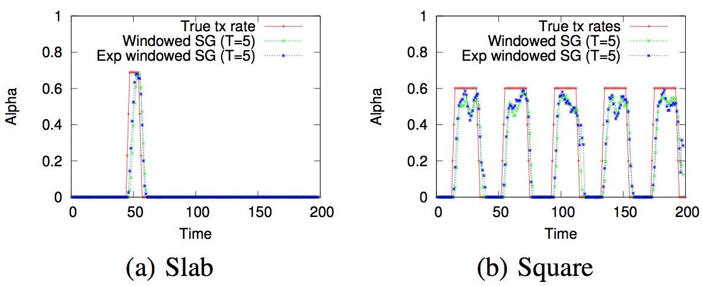
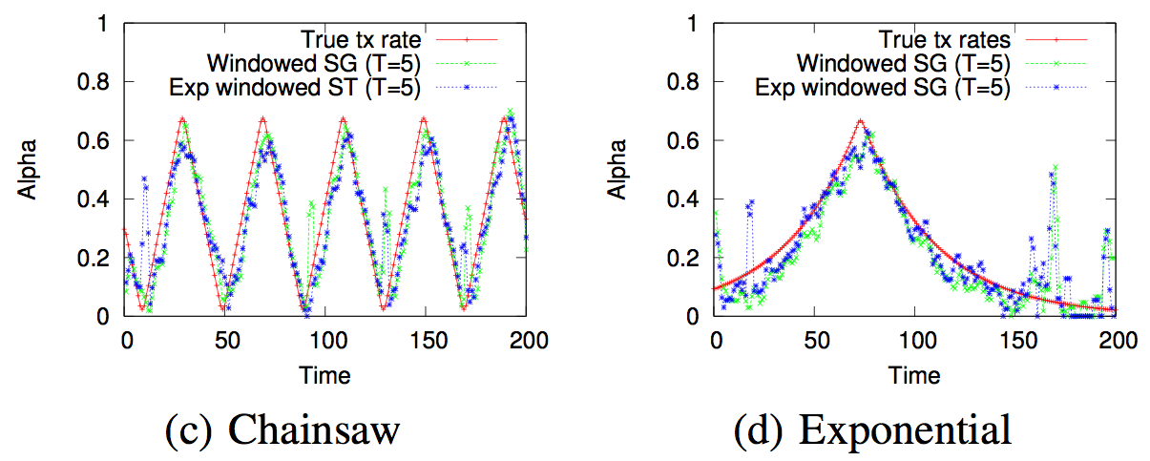
Performance vs rate trend
Our stochastic method is able to track different transmission rate trends

Slide 31
Real experiments: setup
We validate our method on:
Real data
1. We crawl over 179 million quotes from 3.3 million sites from March 2011 to February 2012.
2. We filter posts per topic or news events (in practice, by keywords)
3. We extract memes cascades for every topic/news event
4. Run our algorithm to infer time-varying networks for every topic/news event

Slide 32
Observation I: Dynamic Visualization
Civil war in Libya 2011-10-01 to 2012-02-28 (Gaddafi was killed on 2011-10-20)

Slide 33
Observation I: Dynamic Visualization
Amy Winehouse 2012-01-01 to 2012-02-28

Slide 34
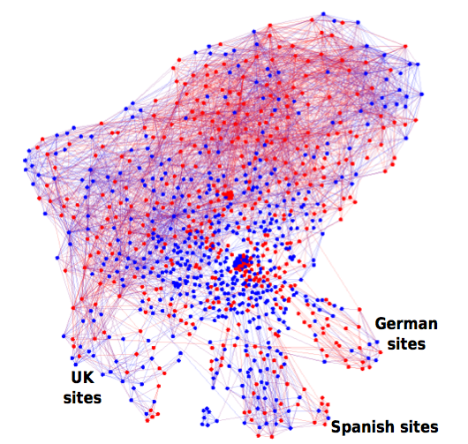
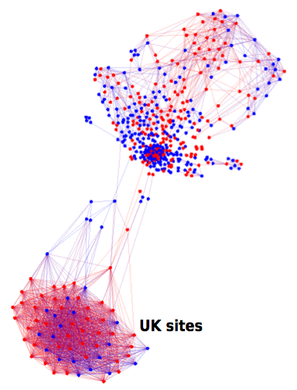
Observation II: Time-varying cluster
UK Royal wedding 2011-05-02 (3 days after the wedding)
UK Royal wedding 2011-11-15 (6 months after the wedding)

Slide 35
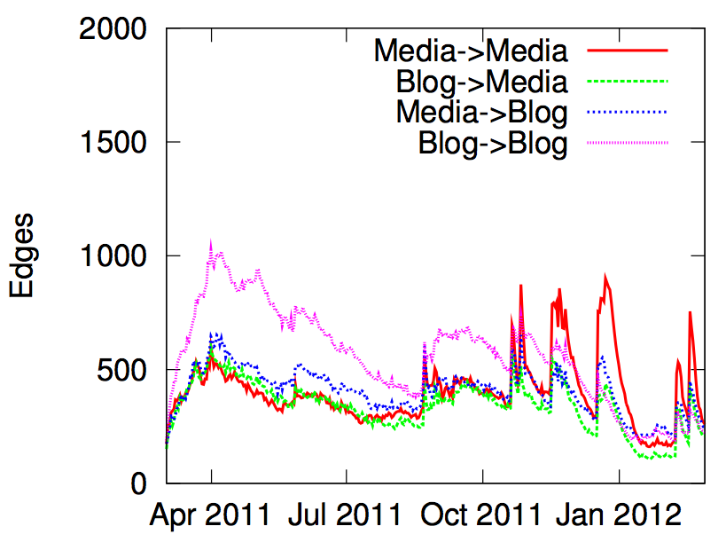
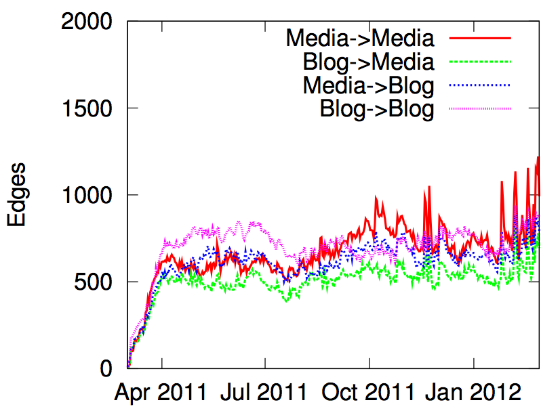
Observation III: civil unrest
Civil war in Libya
Syria’s uprise
News are sometimes spreading earlier among blogs than mass media, often when there is increasing civil unrest, as the civil war in Libya or Syria’s uprise.

Slide 36
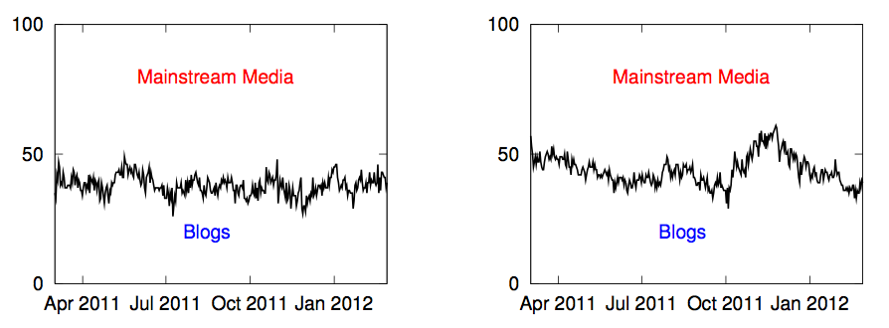
Observation IV: centrality
NBA
Occupy Wall Street
The distribution of mainstream media and blogs among the most central sites can be relatively steady (NBA) or more time-varying (Occupy Wall Street).

Slide 37
Conclusions
We introduced continuous temporal dynamics for modeling diffusion and propagation processes:
We make minimal assumptions about the physical, biological or cognitive mechanisms responsible for diffusion.
The model uses only the temporal traces left by diffusion.
We developed a stochastic method to infer static and dynamic networks from diffusion traces:
We study how real networks and information pathways evolve over time on a massive real dataset.
We consider other research problems (e.g., influence maximization in ICML ’12) under our continuous time model of diffusion.

Slide 38
Thanks!
NetRate (Network Inference):
Gomez-Rodriguez, Balduzzi and Schölkopf, ICML ’11
Gomez-Rodriguez, Leskovec and Schölkopf, (submitted) http://www.stanford.edu/~manuelgr/netrate/ http://www.stanford.edu/~manuelgr/dynamic/
NetInf (network inference):
Gomez-Rodriguez, Krause and Leskovec, KDD ’10
Gomez-Rodriguez, Krause and Leskovec, TKDD ’12
Gomez-Rodriguez and Schölkopf, ICML ’12 http://www.stanford.edu/~manuelgr/netinf/
http://www.stanford.edu/~manuelgr/network-inference-multitree/
InfluMax (Influence Maximization):
Gomez-Rodriguez and Schölkopf, ICML ’12 http://www.stanford.edu/~manuelgr/influmax/

