Slide 1
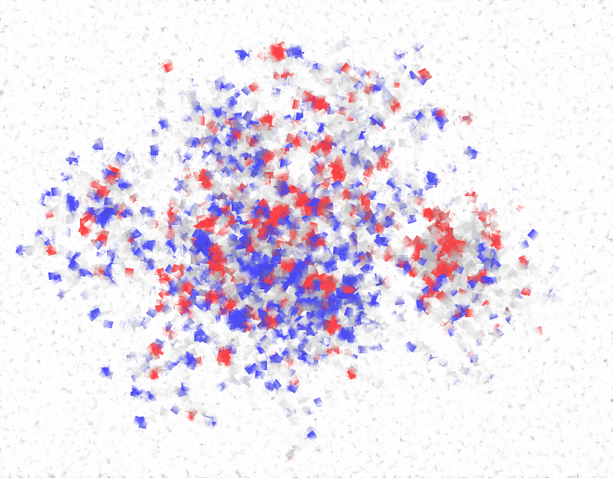
Uncovering the Temporal Dynamics of Diffusion Networks
Manuel Gomez Rodriguez^{1,2} David Balduzzi¹ Bernhard Schölkopf¹
¹ MPI for Intelligent Systems ² Stanford University

Slide 2
Diffusion and propagation
Diffusion and propagation processes occur in many domains:
Information propagation
Social networks
Computer viruses
Viral marketing
Epidemiology
Human travels
Diffusion have raised many different research problems:
Network inference
Influence maximization
Reconstructing cascades
Finding end effectors
Influence minimization
Quarantine policies

Slide 3
Diffusion over networks
Diffusion often takes place over implicit or hard-to-observe networks
Implicit networks of blogs and news sites that spread news without mentioning their sources
Hard-to-observe/hidden networks of drug users that share needles among them
We observe when a node copies information, makes a decision or becomes infected but …
… connectivity, diffusion rates between nodes and diffusion sources are unknown!

Slide 4
Examples of diffusion
Diffusion Process
Available data
Hidden data
Information propagation
Information propagates in the network
Time when blogs reproduce information
Who copied whom
Virus propagation
Viruses propagate in the network
Time when people get sick
Who infected whom
Recommendations propagate in the network
Viral marketing
Time when people buy products
Who influenced whom

Slide 5
Directed Diffusion Network
Directed network over which diffusion processes propagate at different tx rates:
Cascade 1
Cascade 2
Our aim is to infer the network and the dynamics only from the temporal traces
We do not observe edges nor tx rates, only when a diffusion reaches a node.
Notes:
Stronger colors

Slide 6
Related work
Network inference based on diffusion data has been attempted before. What do we improve?!
Our Method
State of the art
NetRate
NetInf (Gomez-Rodriguez, Leskovec & Krause, KDD’10)
CoNNIe (Myers & Leskovec, NIPS’10)
Unique solution
Set # edges
Tune regularizer
Infer temporal dynamics (tx rates)
Fixed temporal dynamics (equal tx rates)
Fixed temporal dynamics (equal tx rates, but infer priors)
Simple convex program
Approximate submodular maximization
Complex convex program with tuning parameter
Notes:
Stronger colors

Slide 7
Outline
Compute the likelihood of the observed cascades
Efficiently find the tx rates that maximize the likelihood of the observed cascades using NetRate
Validate NetRate on synthetic and real diffusion data and compare with state-of-art methods (NetInf & CoNNIe)

Slide 8
Computing the likelihood of a cascade
1. Likelihood of tx of an edge
j
i
2. Probability of survival of a node
l
3. Likelihood of infection of a node
DAG
4. Likelihood of a cascade
k
t_{j}
t_{k}
t_{l}
t_{i}
Infection times
Cascade

Slide 9
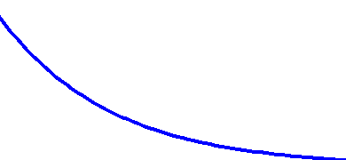
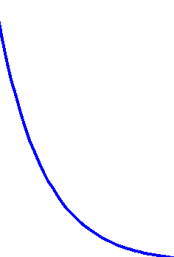
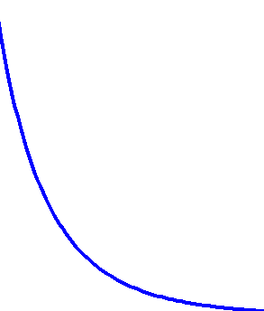
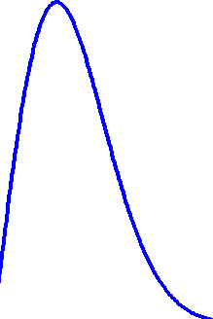
Likelihood of transmission
Likelihood of tx of edge :
j
i
It depends on the tx time (t_{i} – t_{j}) and the tx rate α_{(j, i)}
Exp
Social and Information Diffusion Models
Pow
Epidemiology
Ray
t_{j}-t_{i}
t_{j}-t_{i}
small α_{j,i}
big α_{j,i}
As α_{j,i} 0, likelihood 0 and E[tx time] ∞

Slide 10
Survival and Hazard
The survival function of edge is the probability that node is not infected by node by time t_{i}:
j
i
i
j
t_{j}
t_{i}
The hazard function, or instantaneous infection rate, of edge is the ratio:
j
i

Slide 11
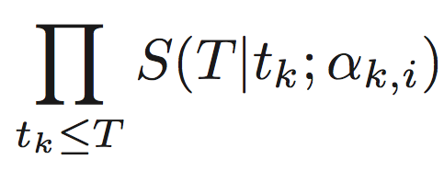
Probability of survival
Probability of survival of a node until time T for a cascade (t₁, ..., t_{N}):
i
≤ 1
j
i
k
l
j
i
k
i
l
i
×
×
t_{j}
T
t_{k}
T
t_{l}
T

Slide 12
Likelihood of an infection
A node gets infected once the first parent infects it.
i
What is the likelihood of infection of node at time t_{i} when node is the first parent?
i
j
i
j
k
l
j
i
k
i
l
i
×
×
t_{j}
t_{i}
t_{k}
t_{i}
t_{l}
t_{i}
Notes:
Add graphs for final version ICML.
First parent, slower parents

Slide 13
Likelihood of an infection
The likelihood of infection of node results from summing up over the mutually disjoint events that each potential parent is the first parent:
i
i
l
×
×
+
j
k
t_{j}
t_{i}
t_{k}
t_{i}
t_{l}
t_{i}
i
l
×
×
+
j
k
t_{j}
t_{i}
t_{k}
t_{i}
t_{l}
t_{i}
i
l
×
×
j
k
t_{j}
t_{i}
t_{k}
t_{i}
t_{l}
t_{i}
Notes:
Add graphs for final version ICML.
First parent, slower parents

Slide 14
Likelihood of a cascade
The likelihood of the infections in a cascade is:
j
Source
i
l
1st infection
2nd infection
3rd infection
k

Slide 15
Network Inference: NetRate
Our goal is to find the transmission rates α_{j,i} that maximize the likelihood of a set of cascades:
Theorem. Given log-concave survival functions and concave hazard functions in A, the network inference problem is convex in A.

Slide 16
Properties of NetRate
The log-likelihood of a set of cascades has three terms with desirable easy-to-interpret properties:
Survival terms
Hazard term

Slide 17
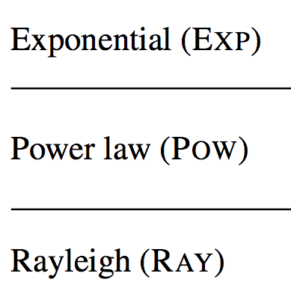
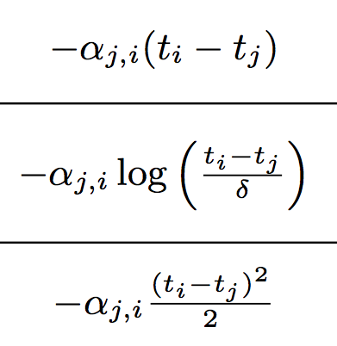
Properties of NetRate
For Exp, Pow and Ray likelihood of tx, the survival terms are positively weighted l₁-norms:
This encourages sparse solutions
It arises naturally within the probabilistic model!

Slide 18
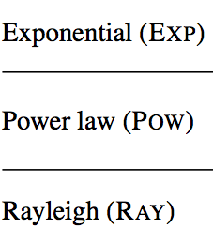
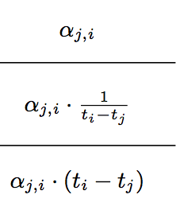
Properties of NetRate
For Exp, Pow and Ray likelihood of tx, the Hazard term ensures infected nodes have at least one parent:
It weakly rewards a node having many parents (natural diminishing property on # of parents).

Slide 19
Solving and speeding-up NetRate
Solving NetRate
We use CVX (Grant & Boyd, 2010) to solve NetRate. It uses successive approximations -- it converges quickly.
Speeding-Up NetRate
1. Distributed optimization:
NetRate splits into N subproblems, one for each node i, in which we find N −1 rates α_{j,i}, j = 1, …, N \ i.
2. Null rates:
If a pair (j, i) is not in any common cascade, the optimal α_{j,i} is zero because it is only weighted negatively in the objective.

Slide 20
Experimental Evaluation
Network connectivity:
Precision-Recall
Accuracy
Transmission rates:
MAE

Slide 21
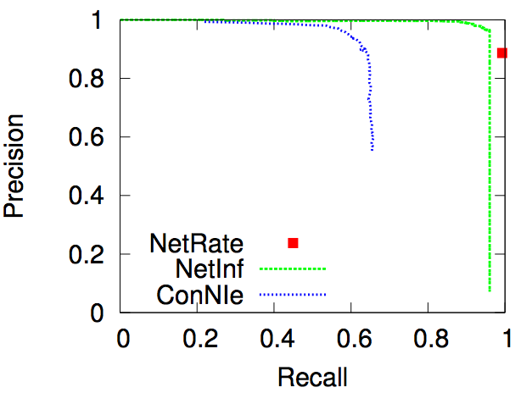
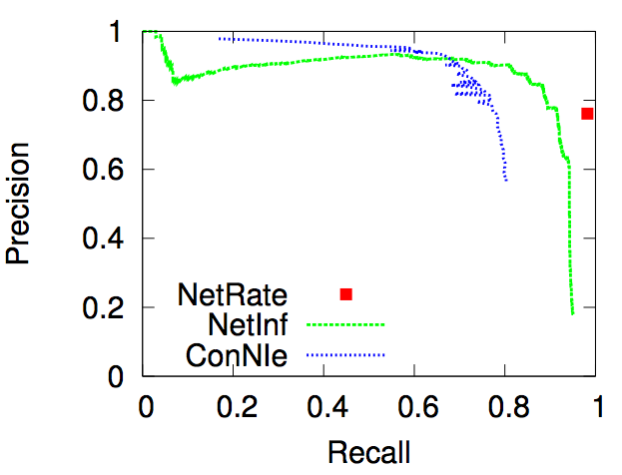
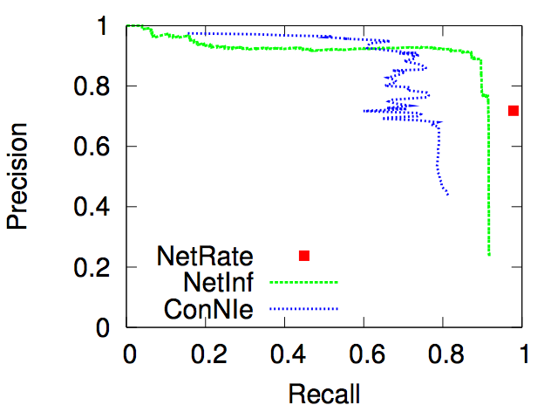
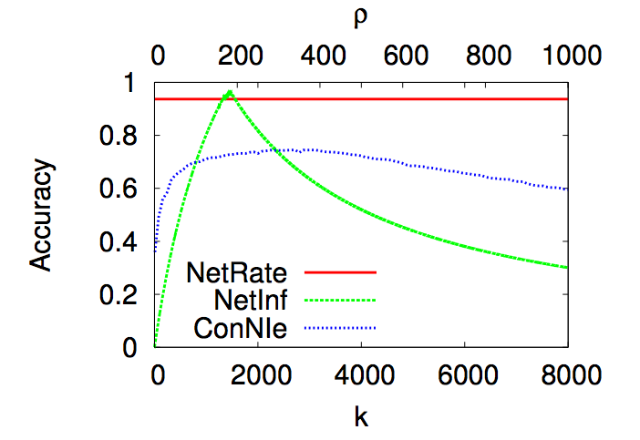
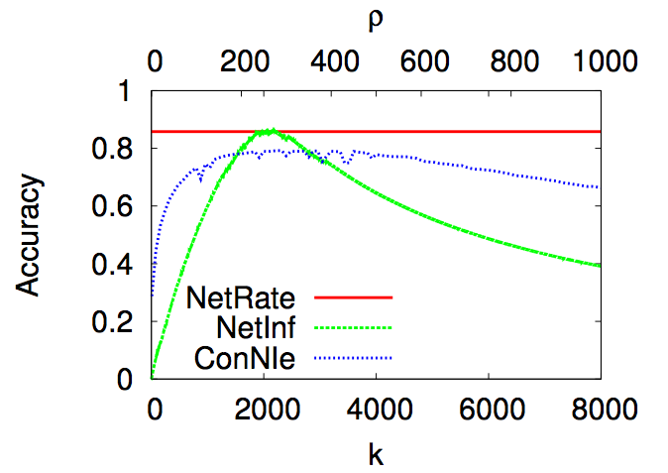
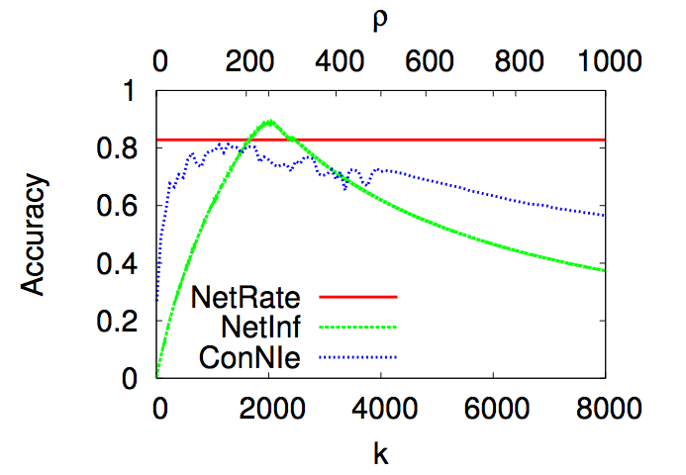
Synthetic Networks: connectivity
Hierarchical Kronecker, Exp
Forest Fire, Pow
Random Kronecker, Ray
1,024 node networks with 5,000 cascades

Slide 22
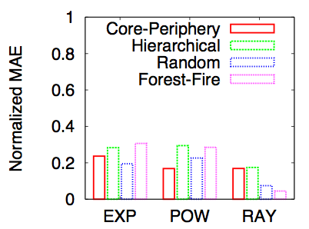
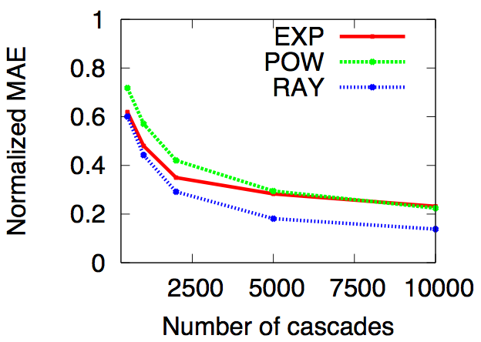
Synthetic Networks: tx rates
Three types of (1,024 nodes, 2,048 edges) Kronecker networks and a (1,024 nodes, 2,422 edges) Forest Fire network with 5,000 cascades (optimization over 1,024 x 1,024 variables!)

Slide 23
Real Network: data
MemeTracker dataset:
172m news articles from Aug ’08 – Sept ’09
We aim to infer the network of information diffusion
Which real diffusion data do we have from MemeTracker?
Diffusion Network
Cascades (Diffusion processes)
We use the hyperlinks between sites to generate the edges of the network
We have the time when a site create a link ➔ cascades of hyperlinks

Slide 24
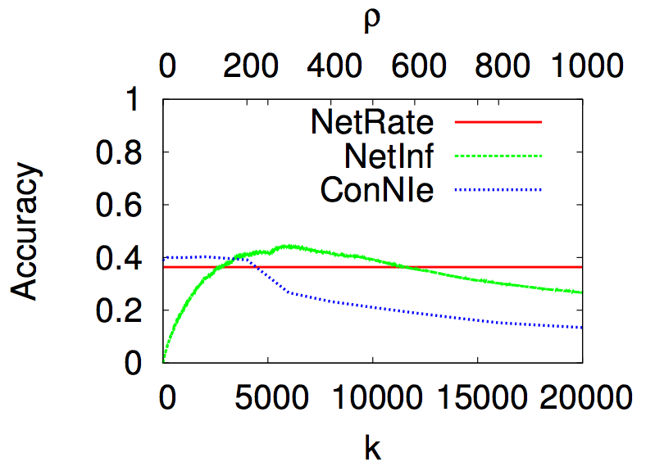
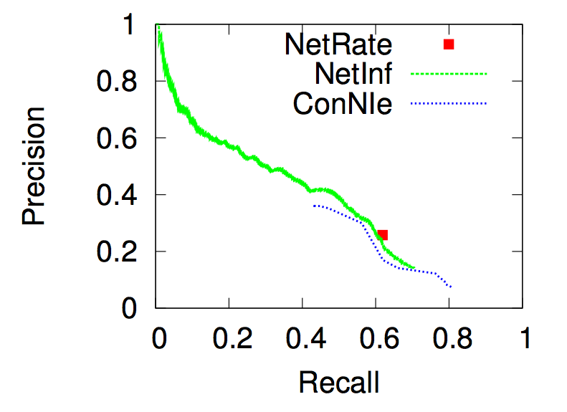
Real Network: connectivity
(500 node, 5000 edges) hyperlink network using hyperlinks cascades
NetRate outperforms state-of-the-art across a significant part of the full range of their tunable parameters.
Parameter tuning in other methods is largely blind.

Slide 25
Conclusions
NetRate is a flexible model of the spatiotemporal structure underlying diffusion processes:
We make minimal assumptions about the physical, biological or cognitive mechanisms responsible for diffusion.
The model uses only the temporal traces left by diffusion.
Introducing continuous temporal dynamics simplifies the problem dramatically:
Well defined convex maximum likelihood problem with unique solution.
No tuning parameters, sparsity follows naturally from the model.

Slide 26
Future work
How do different transmission rates distributions, length of observation window, etc… impact NetRate?
Build on NetRate for inferring transmission rates in epidemiology, neuroscience, etc.
Support the threshold model in our formulation:
A node gets infected when several of its neighbours infect it.
Re-think related problems under our continuous time diffusion model:
Influence maximization (marketing), spread minimization (epidemiology, misinformation), incomplete diffusion data (many fields), confounders detection (many fields), etc…

Slide 27
Thanks!
http://www.stanford.edu/~manuelgr/netrate/ (code & more)

