Slide 1
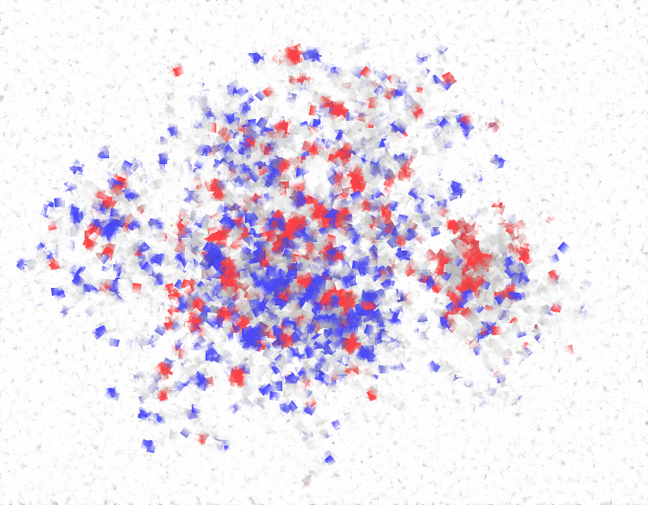
Submodular Inference of Diffusion networks from Multiple Trees
Manuel Gomez Rodriguez^{1,2} Bernhard Schölkopf¹
¹ MPI for Intelligent Systems ² Stanford University
29.06.12, ICML ‘12

Slide 2
Propagation
Propagation takes place on
We can extract propagation traces from
Information Networks
Social Networks
Recommendation Networks
Epidemiology
Human Travels

Slide 3
Propagation over unknown networks
Diffusion often takes place over implicit or hard-to-observe highly dynamic networks
Implicit networks of blogs and news sites that spread news without mentioning their sources
Hard-to-observe/hidden networks of drug users that share needles among them
We observe when a node copies information or becomes infected but …
… connectivity and diffusion sources are unknown!

Slide 4
Examples of diffusion
Diffusion Process
Available data
Hidden data
Information propagation
Information propagates in the network
Time when blogs reproduce information
Who copied whom
Virus propagation
Viruses propagate in the network
Time when people get sick
Who infected whom
Recommendations propagate in the network
Viral marketing
Time when people buy products
Who influenced whom
Can we infer the hidden data from the available temporal data?

Slide 5
Directed Diffusion Network
Directed network over which cascades propagate:
n₄
Cascade 1
n₃
Cascade 2
n₇
Our aim is to infer the network before it changes from a few temporal traces
n₂
n₅
n₆
n₁
Cascade 1: (n₁, t₁=1), (n₂, t₂=4), (n₃, t₃=6), (n₄, t₄=10)
Cascade 2: (n₂, t₁=3), (n₅, t₂=10), (n₃, t₃=12), (n₄, t₄=23), …
Notes:
Stronger colors

Slide 6
Outline
Efficiently compute the likelihood of the observed cascades
Efficiently find the network that maximize the likelihood of the observed cascades
Validate our algorithm on synthetic and real diffusion data and compare with state-of-art methods (NetRate, ConNIe & NetInf)

Slide 7
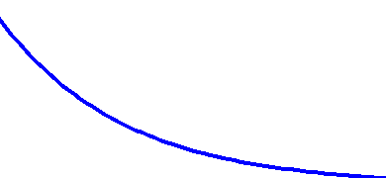
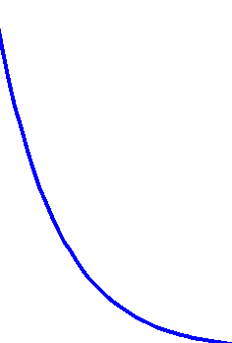
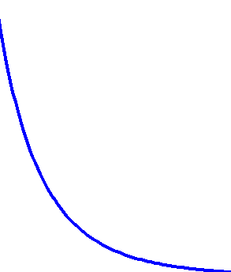
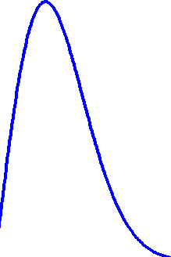
Pairwise interactions
Prior probability of transmission of edge :
j
i
Suppose node gets infected, is the probability that a cascade propagates over an edge (j, i)
j
Likelihood of transmission time :
j
i
It depends on the transmission time (t_{i} – t_{j}) and the rate α_{(j, i)}
For simplicity, three parametric transmission models:
Social and Information Diffusion Models
Exp
Pow
Epidemiology
Ray
t_{j}-t_{i}
t_{j}-t_{i}
small α_{j,i}
big α_{j,i}
As α_{j,i} 0, E[tx time] ∞

Slide 8
Probability of a tree in a given network
There are several propagation trees
Given a cascade
t₃
t₅
T₁
T₂
t₁
t₄
t₂
T₃
T₄
Each node infected by a single parent
Assume the same prior probability of tx for each edge, the probability of any feasible tree given a network is:
q: # edges in T r: # inactive edges

Slide 9
Likelihood of a cascade for a given tree
Consider a particular feasible tree T for a cascade, the likelihood of the cascade given the tree T is:
Example:
t₅
t₃
t₁
t₄
t₂
f(t^{c} | T) = f(t₂ | t₁ ; α) f(t₃ | t₁ ; α) f(t₄ | t₃ ; α) f(t₅ | t₃ ; α)

Slide 10
Likelihood of a cascade in a given network
Consider a cascade t^{c} spreading over a a network G, the likelihood of the cascade in the network is:
Likelihood of a cascade given a tree T
Probability of a tree T in the network G
Set of trees induced by the cascade t^{c} in the network G
There are O(n^{n}) possible propagation trees per cascade!

Slide 11
Likelihood of a cascade in a given network
Even though O(n^{n}) possible propagation trees per cascade
Matrix Tree Theorem
We compute f(t^{c} | T) by solving det(A), where A is a matrix that we build in O(n²)
Time ordering A is upper triangular, we compute det(A) in O(n)
How?!
We are able to compute the likelihood f(t^{c} | T) in O(n²)
Finally, the log-likelihood of a cascade set C over a network G is:

Slide 12
Network Inference Problem
We have shown how to compute the likelihood of a cascade set in a network G. However, our aim is to find the optimal network G with k edges that maximizes the likelihood:
(1)
Unfortunately,
Theorem. The network inference problem defined by Eq. (1) is NP-hard.

Slide 13
Submodular maximization
However, our objective function satisfies a natural diminishing property:
Theorem. The objective function is a submodular function in the set of edges in G.
We can efficiently obtain a suboptimal solution with a 63% provable guarantee
using a greedy algorithm

Slide 14
Experimental Setup
We validate our method on:
Synthetic data
1. Generate network
2. Generate a few cascades over the network
3. Run our inference algorithm
Real data
1. MemeTracker data (172m news articles 08/2009– 09-2009)
2. We extract hyperlink cascades
3. Run our inference algorithm
How does our algorithm perform in comparison with state-of-the-art?
How fast do we infer a network?
How does our algorithm perform with respect to the amount of observed cascades?

Slide 15
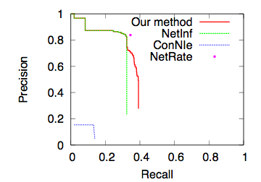
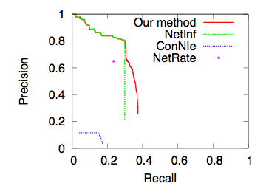
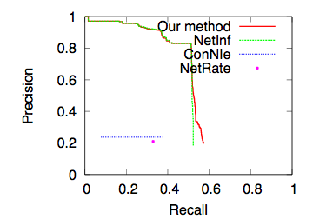
Precision vs Recall
Erdos-Renyi, Exp
Hierarchical, Pow
Core Periphery, Ray
1,024 node networks with 200 cascades
Our algorithm discovers greater number of edges; it reaches a higher recall

Slide 16
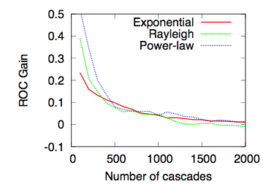
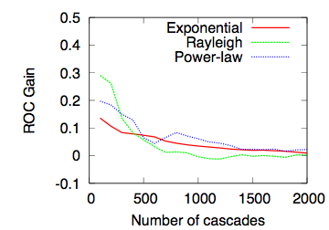
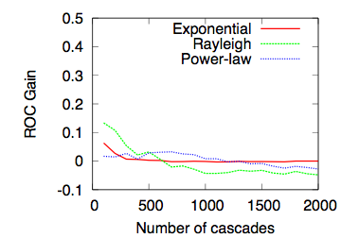
ROC gain wrt NetInf vs # cascades
Erdos-Renyi
Hierarchical
Core Periphery
1,024 node networks
Our algorithm outperform NetInf by ≈10-20% for small cascade sets and performs similarly for large cascade sets
The ROC gain depends on the network structure and transmission model

Slide 17
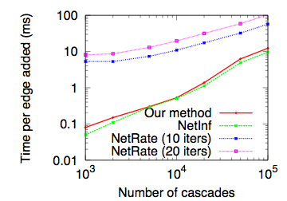
Scalability
Considering all trees (in contrast with single tree inference in NetInf) does not impact scalability significantly
Both our method and NetInf are typically more than one order of magnitude faster than NetRate

Slide 18
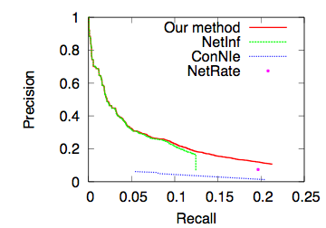
Real Network: performance
(1,000 node, 10,000 edges) hyperlink network, 1,000 hyperlinks cascades
Our method outperforms the state-of-the-art for most of the full range of their tunable parameters.

Slide 19
Conclusions
We infer hidden networks from small sets of cascades
In our algorithm:
We use Matrix Tree Theorem & time ordering to compute cascades likelihoods efficiently in O(N²)
We show submodularity of the objective function in the network inference problem (open problem from KDD’10), which allows us to solve it efficiently
We beat the state of the art when only a few cascades are recorded

Slide 20
Thanks!
Code & More:
http://www.stanford.edu/~manuelgr/network-inference-multitree/

