Slide 1
Influence Maximization in Continuous Time Diffusion Networks
Manuel Gomez Rodriguez Bernhard Schölkopf
29.06.12, ICML ‘12

Slide 2
Propagation
Propagation takes place on
We can extract propagation traces from
Information Networks
Social Networks
Recommendation Networks
Epidemiology
Human Travels

Slide 3
Influence Maximization
0
T
Our aim: Find the optimal source nodes that maximize the average number of infected nodes by T:
0
T

Slide 4
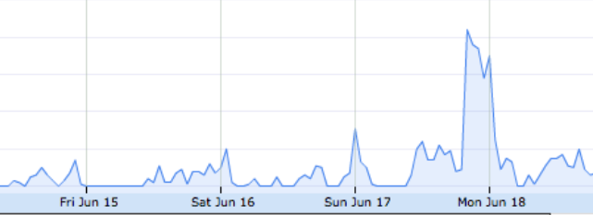
Continuous time vs sequential model
TRADITIONALLY…
j
i
Propagation has been modeled as sequential rounds in discrete time steps
Probability of transmission
#greece retweets
HOWEVER, REAL TIME MATTERS…
IN OUR WORK…
j
i
Propagation is modeled as a continuous process with different rates
Likelihood of transmission

Slide 5
Influence Maximization: Outline
Describe the evolution of a diffusion process mathematically
Analytically compute the influence in continuous time
Efficiently find the source nodes that maximizes influence
Validate InfluMax on synthetic and real diffusion data

Slide 6
Sources and sink node
n
Set of source nodes A: Nodes in which a diffusion process starts
Sink node n: Node under study. We aim to evaluate its probability of infection before T given A: P(t_{n} < T | A)
Source node
Sink node n

Slide 7
Domination: disabled nodes
Given a sink node n and a set of infected nodes I, we define the disabled nodes S_{n}(I) dominated by I:
A node u is disabled if any path from u to n visits at least one infected node
n
2
9
Infected node
1
Sink node n
3
4
Disabled node
8
5
6
6
7
7

Slide 8
Self domination: disabled sets
We define the set of self-dominant disabled sets :
Nodes in a self-dominant disable set only block themselves relative to the sink node n
2
1
8
9
3
4
5
Infected
6
7
Sink node n
We can find
them all efficiently!

Slide 9
Monitoring a diffusion process
Given a sink node n and a diffusion process starting in a source set A:
We show that a diffusion process can be described by the state space of self-dominant disabled sets
This means that…
The probability of infecting the sink node n before T is the probability of reaching a specific disabled set before T

Slide 10
Diffusion process: continuous time
Given a diffusion process, how fast do we traverse from one self-dominant disable set to another?
Disabled set III
Disabled set I
Disabled set II
Disabled set IV
It depends on how quickly information propagates between each pair of nodes
j
i
Likelihood of transmission

Slide 11
Diffusion process as a CTMC
Theorem. Given a source set A, a sink node n and independent exponential likelihoods , the process is a CTMC with state space
This means that…
The probability of infection of the sink node n before T is a phase type distribution
Exp matrix depends on and T

Slide 12
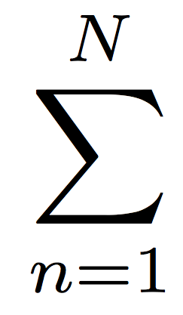
Computing influence
We sum up over all nodes in the network
We know how to compute the probability of infection of any sink node n before T
INFLUENCE

Slide 13
Maximizing the influence
Until now, we show how to compute influence. However, our aim is to find the optimal set of sources nodes A that maximizes influence:
(1)
Unfortunately,
Theorem. The continuous time influence maximization problem defined by Eq. (1) is NP-hard.

Slide 14
Submodular maximization
There is hope! The influence function satisfies a natural diminishing property:
Theorem. The influence function is a submodular function in the set of nodes A.
We can efficiently obtain a suboptimal solution with a 63% provable guarantee
using a greedy algorithm

Slide 15
Experimental Setup
We validate our method on:
Synthetic data
1. Generate network structure
2. Assign transmission rate to each edge in the network
3. Run InfluMax
Real data
1. MemeTracker data (172m news articles 08/2009– 09-2009)
2. We infer diffusion networks from hyperlink or memes cascades
3. Run InfluMax
What is the optimal source set that maximizes influence?
How does the optimal source set change with T?
How fast is the algorithm?

Slide 16
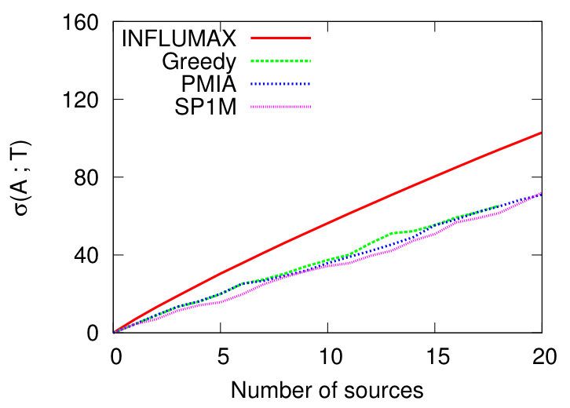
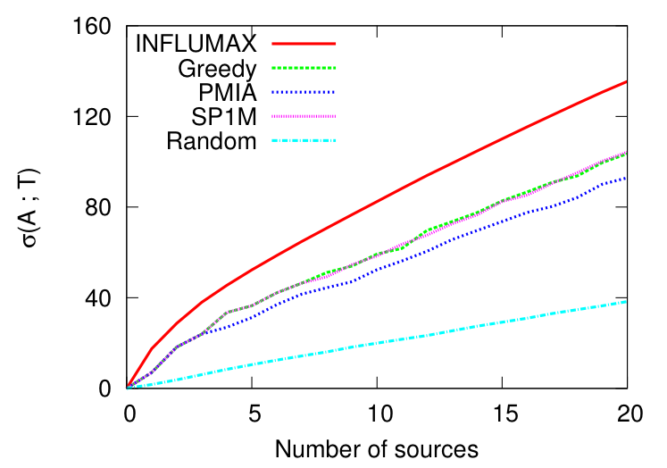
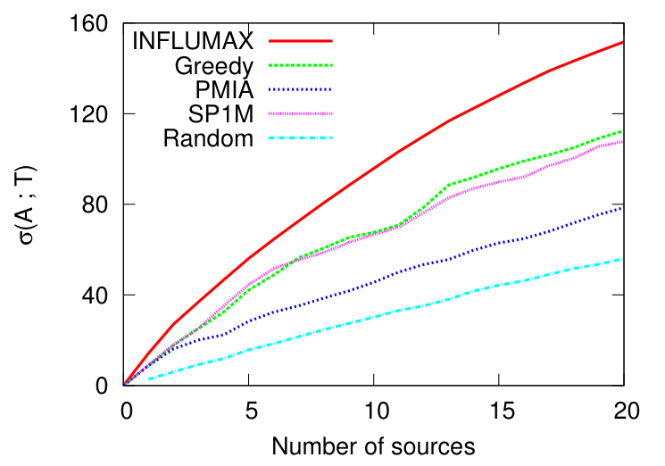
Influence vs. number of sources
1024-node Forest Fire
1024-node Hierarchical Kronecker
512-node Random Kronecker
Performance does not depend on the network structure:
Synthetic Networks: Forest Fire, Kronecker, etc.
InfluMax typically outputs source sets that results in a 20% higher influence than competitive methods!

Slide 17
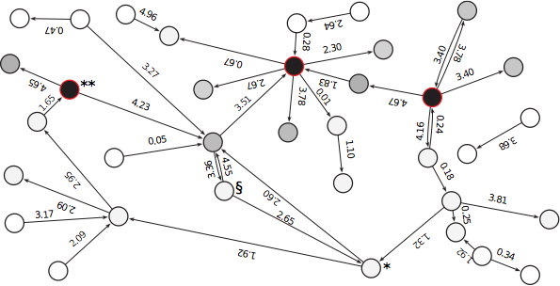
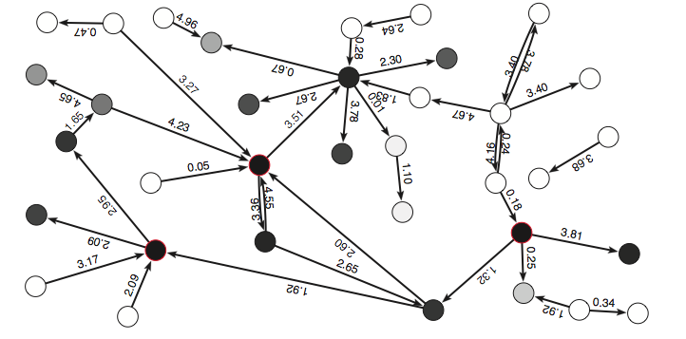
Influence vs. time horizon
T = 0.1
The source set outputted by InfluMax can change dramatically with the time horizon T
For which time horizon does InfluMax gives the greatest competitive advantage?
T = 1

Slide 18
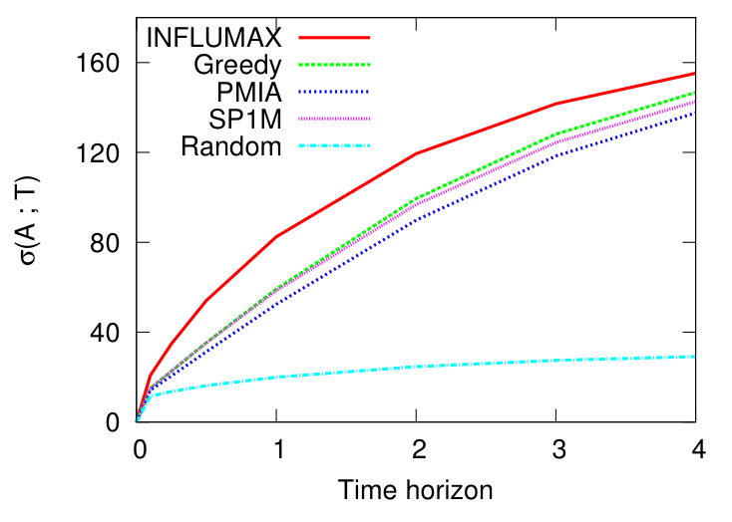
Influence vs. time horizon
1024-node Hierarchical Kronecker network
In comparison with other methods, InfluMax performs best for relatively small time horizon.

Slide 19
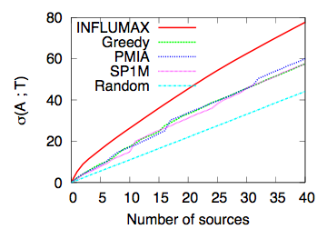
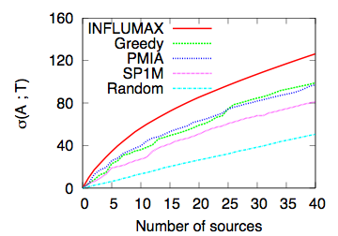
Real data: Influence vs. # of sources
1000-node real network (inferred from hyperlink cascades)
1000-node real network (inferred from MemeTracker cascades)
InfluMax outputs a source set that results in a 20-25% higher influence than competitive methods!

Slide 20
Conclusions
We model diffusion and propagation processes in continuous time:
We make minimal assumptions about the physical, biological or cognitive mechanisms responsible for diffusion.
The model uses only the temporal traces left by diffusion.
Including continuous temporal dynamics allows us to evaluate influence analytically using CTMCs.
Once we compute the CTMC, it is straight forward to evaluate how changes in transmission rates impact influence
Natural follow-up: use event history analysis/hazard analysis to generalize our model

Slide 21
Thanks!
Code & More:
http://www.stanford.edu/~manuelgr/influmax/

