Slide 1

BCI-based Robot Rehabilitation
Framework for Stroke Patients
M. Gomez-Rodriguez^{1,2} J. Peters ¹ J.. Hill ¹ A. Gharabaghi ³
B. Schölkopf ¹ M.. Grosse-Wentrup ¹
¹ MPI for Biological Cybernetics
² Stanford University
³ University Hospital Tuebingen
International BCI Meeting, June 2010

Slide 2
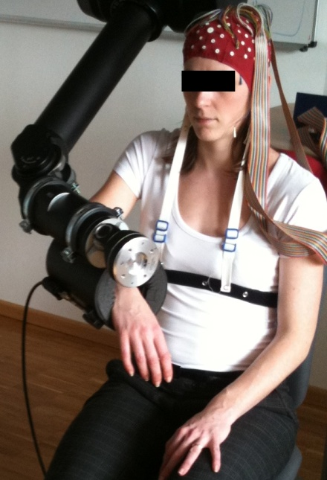
Introduction
Stroke: leading cause of long-term motor disability among adults.
Loop is broken!!
We close the loop!!
Current rehabilitative interventions do not help for severe motor impairment.
BCIs + robot-assisted physical therapy → neurorehabilitation of stroke patients.
Brain signal based reinforcement of the patient's intent to move using a robot arm → Hebbian rule-based*.
* T. H. Murphy, and D. Corbett. Plasticity during stroke recovery: from synapse to behaviour. Nature Review Neurosci. 2009, 10-12, 861-872.

Slide 3
Challenges
Instantaneous feedback
  Make the subjects think they are controlling the robot arm.
  Synchronize user’s attempt and robot action.
High accuracy (user’s control)
High specificity (ECoG vs EEG)

Slide 4
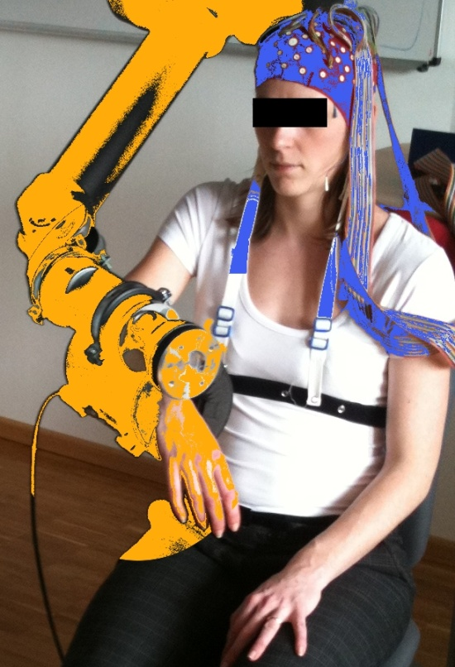

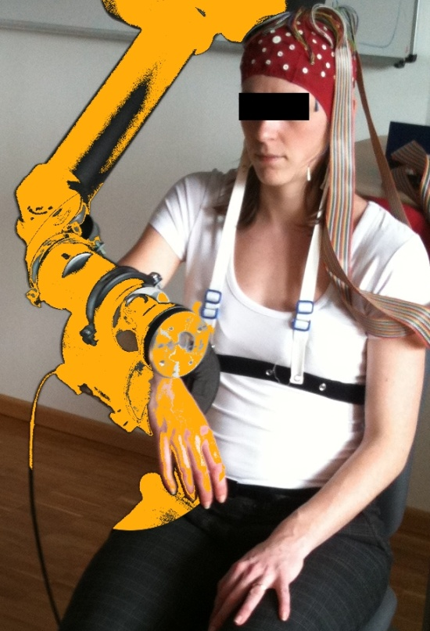
Progress to date
On-line decoding (Epidural ECoG)
Haptic feedback helps on-line decoding
M. Gomez-Rodriguez, J. Peters, J. Hill, B. Schölkopf, A. Gharabaghi, and M. Grosse-Wentrup. Closing the Sensorimotor Loop: Haptic Feedback Facilitates Decoding of Arm Movement Imagery. SMC Workshop in Shared-Control for BMI, 2010.
M. Gomez-Rodriguez, J. Peters, J. Hill, B. Schölkopf, A. Gharabaghi, and M. Grosse-Wentrup. Closing the Sensorimotor Loop: Haptic Feedback Facilitates Decoding of Arm Movement Imagery. SMC Workshop in Shared-Control for BMI, 2010.
M. Gomez-Rodriguez, M. Grosse-Wentrup, J. Peters, G. Naros, J. Hill, B. Schölkopf, and A. Gharabaghi. Epidural ECoG Online Decoding of Arm Movement Intention in Hemiparesis. ICPR Workshop on Brain Decoding, 2010.
M. Gomez-Rodriguez, M. Grosse-Wentrup, J. Peters, G. Naros, J. Hill, B. Schölkopf, and A. Gharabaghi. Epidural ECoG Online Decoding of Arm Movement Intention in Hemiparesis. ICPR Workshop on Brain Decoding, 2010.

Slide 5
Epidural ECoG on-line decoding
On-line decoding (Epidural ECoG)
M. Gomez-Rodriguez, M. Grosse-Wentrup, J. Peters, G. Naros, J. Hill, B. Schölkopf, and A. Gharabaghi. Epidural ECoG Online Decoding of Arm Movement Intention in Hemiparesis. ICPR Workshop on Brain Decoding, 2010.

Slide 6
Epidural ECoG on-line decoding: Setup
65-year old male, right-sided hemiparesis (hemorrhagic stroke in left thalamus)
96 epidural ECoG electrodes: somato-sensory, motor and pre-motor cortex.
Subject’s task: attempt to move the right arm forward or backward.
M. Gomez-Rodriguez, M. Grosse-Wentrup, J. Peters, G. Naros, J. Hill, B. Schölkopf, and A. Gharabaghi. Epidural ECoG Online Decoding of Arm Movement Intention in Hemiparesis. ICPR Workshop on Brain Decoding, 2010.

Slide 7
Epidural ECoG on-line decoding: Results
On-line decoding of arm movement intention of a stroke patient → ~90% accuracy.
  High accuracy
Information given by each electrode for on-line decoding → cortical reorganization caused by the stroke.
  High specificity
M. Gomez-Rodriguez, M. Grosse-Wentrup, J. Peters, G. Naros, J. Hill, B. Schölkopf, and A. Gharabaghi. Epidural ECoG Online Decoding of Arm Movement Intention in Hemiparesis. ICPR Workshop on Brain Decoding, 2010.

Slide 8

Haptic feedback helps on-line decoding
Haptic feedback helps on-line decoding
M. Gomez-Rodriguez, J. Peters, J. Hill, B. Schölkopf, A. Gharabaghi, and M. Grosse-Wentrup. Closing the Sensorimotor Loop: Haptic Feedback Facilitates Decoding of Arm Movement Imagery. SMC Workshop in Shared-Control for BMI, 2010.

Slide 9
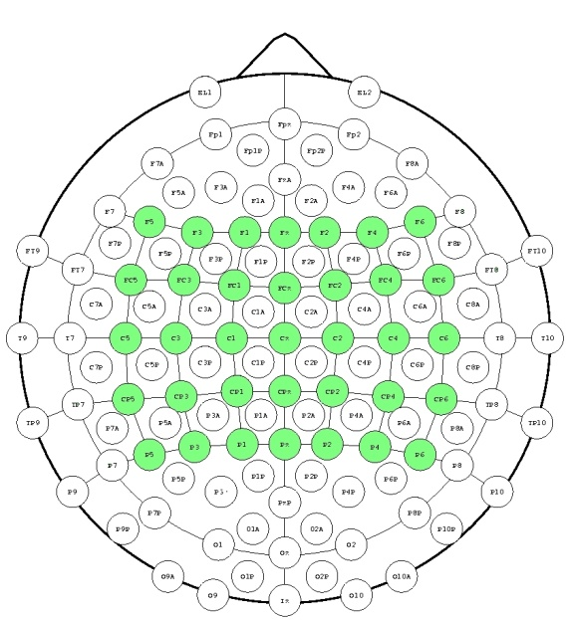
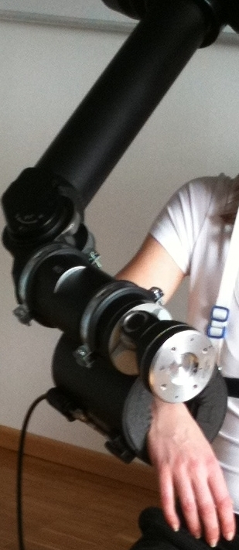
Haptic feedback helps on-line decoding: Setup
6 right handed healthy subjects, 35 EEG electrodes
Subject’s task: think about moving the arm forward or backward.
A robot arm guides subject’s arm → On-line Haptic feedback (every 300 ms go/no go)
M. Gomez-Rodriguez, J. Peters, J. Hill, B. Schölkopf, A. Gharabaghi, and M. Grosse-Wentrup. Closing the Sensorimotor Loop: Haptic Feedback Facilitates Decoding of Arm Movement Imagery. SMC Workshop in Shared-Control for BMI, 2010.

Slide 10
Haptic feedback helps on-line decoding: Results
Haptic feedback increases discriminative power of the neural signals.
Sensory area is more informative when haptic feedback is provided.
Haptic Feedback
No Haptic Feedback
Haptic Feedback
The Beta band increases its discriminative power during haptic feedback.
No Haptic Feedback
M. Gomez-Rodriguez, J. Peters, J. Hill, B. Schölkopf, A. Gharabaghi, and M. Grosse-Wentrup. Closing the Sensorimotor Loop: Haptic Feedback Facilitates Decoding of Arm Movement Imagery. SMC Workshop in Shared-Control for BMI, 2010.

Slide 11
Conclusions
Our framework closes the sensory motor loop.
With Epidural ECoG,
  High accuracy
  High specificity
Haptic feedback improves on-line decoding.
Next step: combine ECoG decoding in stroke patients with haptic feedback!

Slide 12
Thank You!

